Slide 1




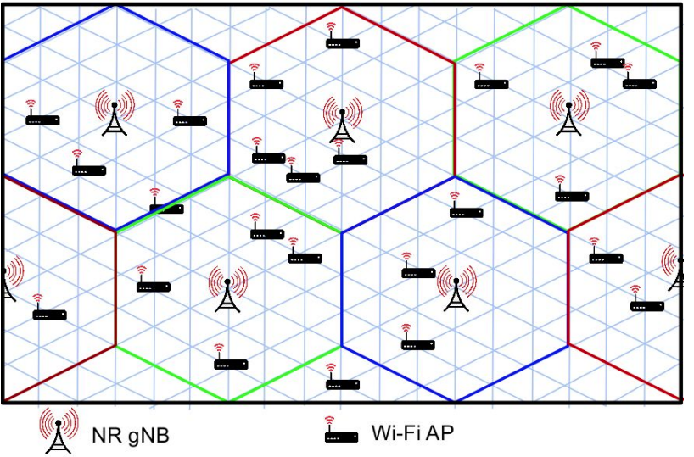
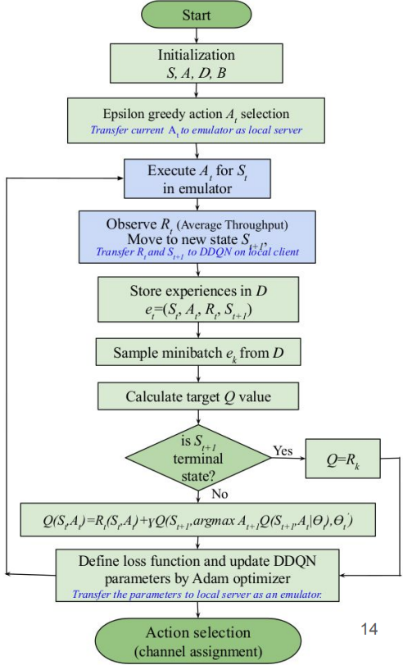
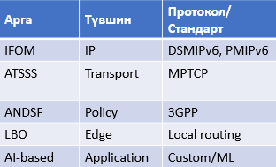
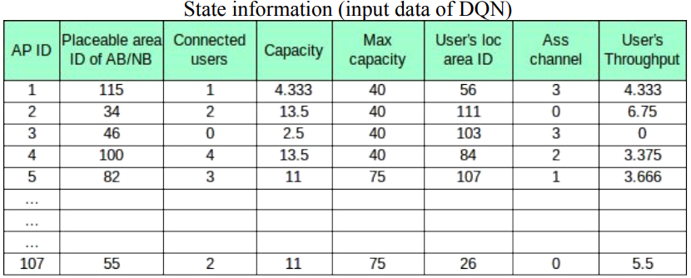
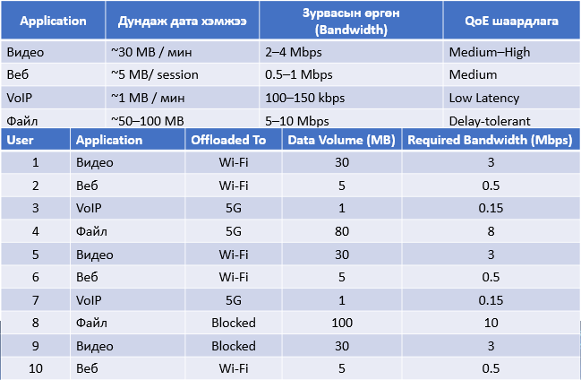
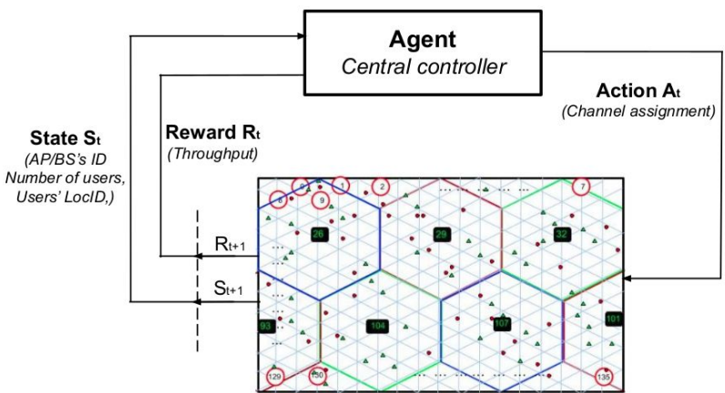
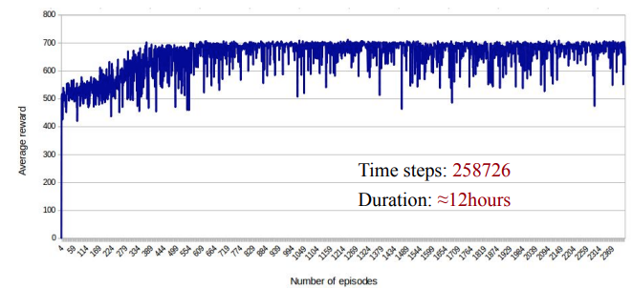

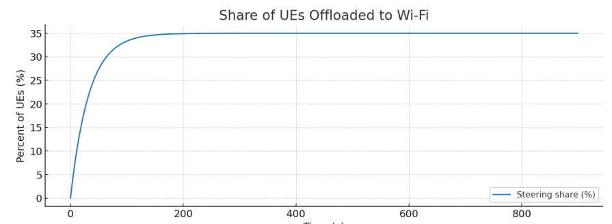
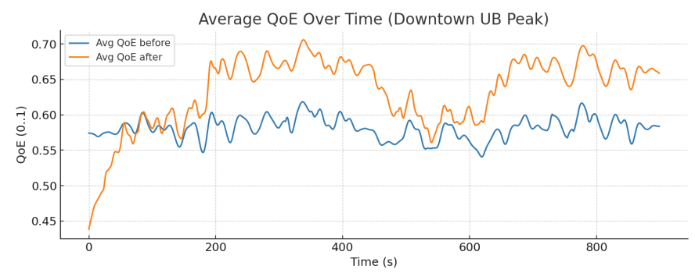
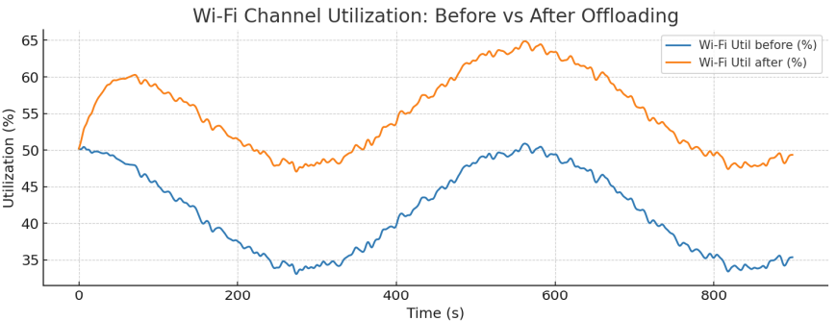
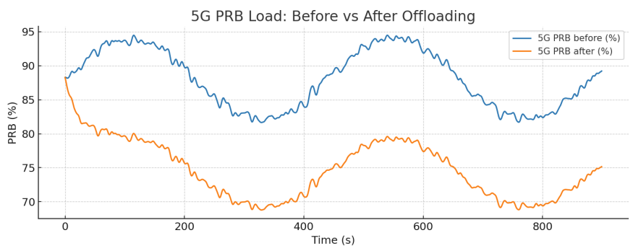
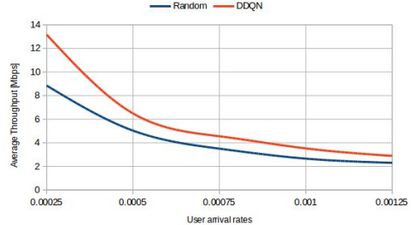
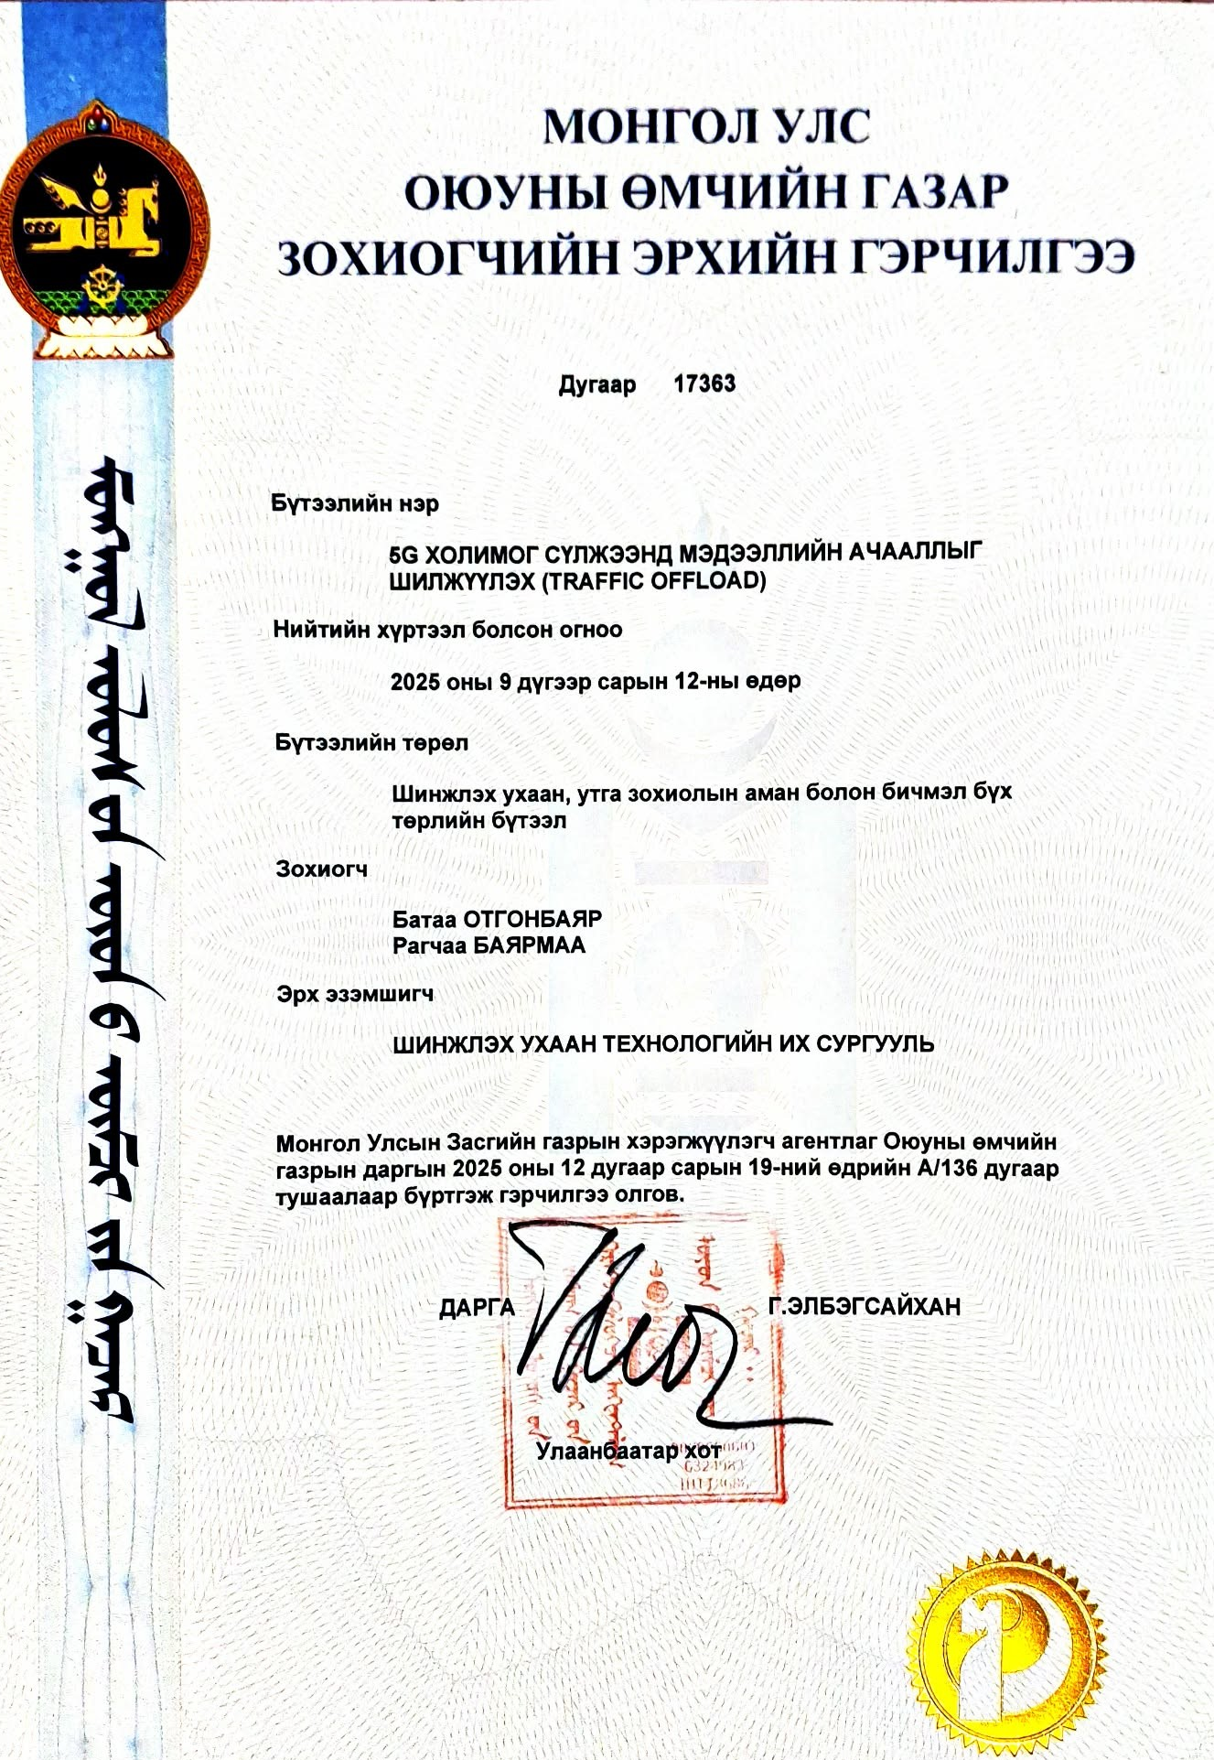
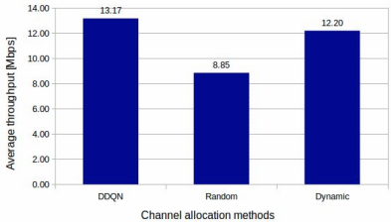
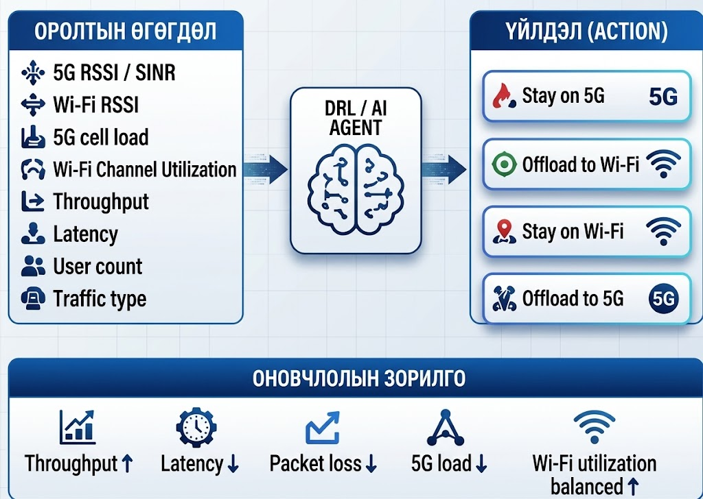

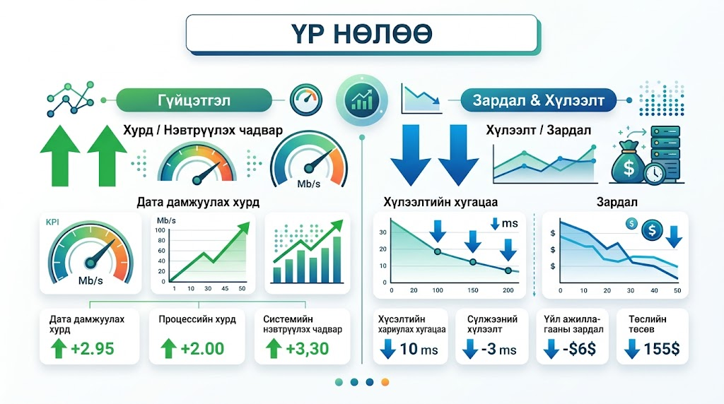
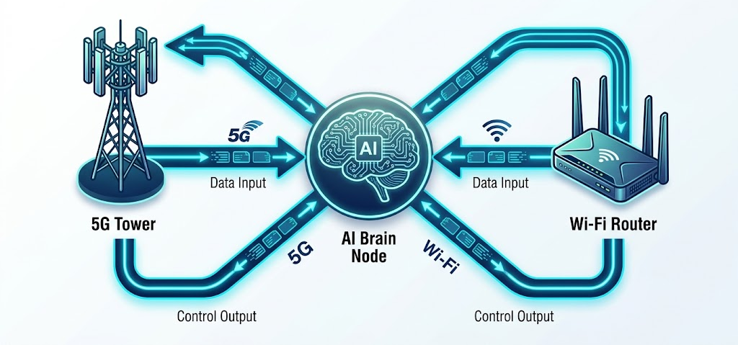
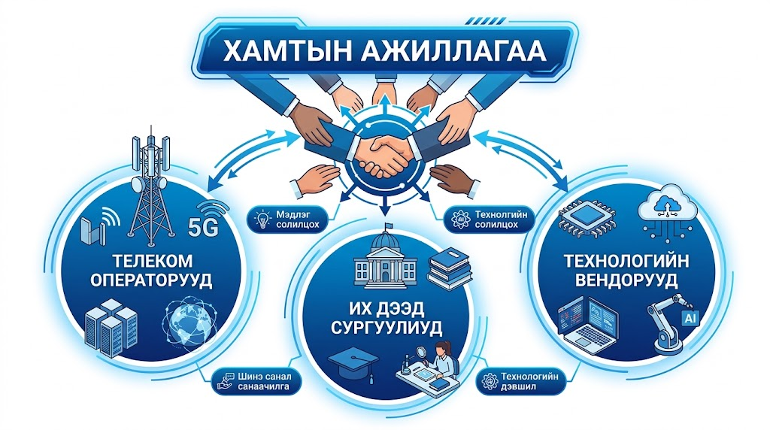
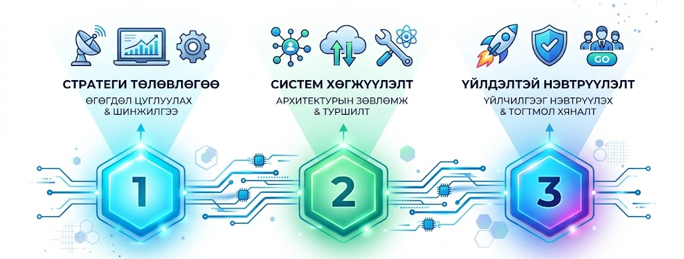

DDQN-р суваг хуваарилалт хийх алгоритм
M-JEED
LOGO
MINISTRY
LOGO
HIGHER EDUCATION PROJECT IN ENGINEERING AND TECHNOLOGY
MONGOLIA–JAPAN JOINT RESEARCH AND BUSINESS PARTNERSHIP – 2026
September 17, 2026 | Ulaanbaatar, Mongolia
Research Priority Area:
Automation and Systems Engineering
A STUDY ON THE DEVELOPMENT OF SMART SYSTEMS FOR INDUSTRIAL, SERVICE, AND DOMESTIC APPLICATIONS USING ADVANCED TECHNOLOGIES
A Study on Traffic Offloading Capabilities and Performance in 5G Heterogeneous Networks
Keywords: IFOM, ATSSS, ANDSF, LBO, Wi-Fi Traffic Offloading, mmWave
MONGOLIAN PROJECT TEAM LEADER
JAPANESE PROJECT TEAM LEADER
Ass. Professor Kishikawa Hiroki, Ph.D.
Tokushima University/ Faculty of Science and Technology
kishikawa.Hiroki@tokushima-u.ac.jp
Professor B. Otgonbayar, Ph.D.
School of Information and Communication Technology/Department of Telecommunication Engineering
Email: otgonbayar_b@must.edu.mn
RESEARCH TEAM MEMBER
R.Bayarmaa, Ph.D.
School of Information and Communication Technology/Department of Telecommunication Engineering
bayarmaa.r@must.edu.mn
RESEARCH TEAM MEMBER
Professor Kazuhiko Kinoshita, Ph.D.
Tokushima University/ Faculty of Science and Technology
kazuhiko@is.tokushima-u.ac.jp
1. PROBLEM & RESEARCH OBJECTIVES
2. METHODOLOGY & COLLABORATION
DRL-Based Channel Allocation
CAUSES OF NETWORK CONGESTION IN 5G NETWORKS
Increasing Number of Users
High Data Demand and URLLC Traffic
Insufficient Number of Base Stations
Inefficient Resource Management and Allocation
Interference and Other Factors
OBJECTIVES
Efficient Channel Allocation in Wireless Heterogeneous Networks Using Deep Reinforcement Learning (DRL)
Reducing Network Congestion in 5G/Wi-Fi Heterogeneous Networks
DDQN-Based Channel Allocation Algorithm
Input Data Used for Training
Agent–Environment Interaction
3. KEY OUTCOMES, TECHNOLOGIES & PRODUCTS
Results of the DDQN Model
Copyright Certificate
Intellectual Property Office of Mongolia
Traffic Offloading in High-Traffic Areas of Ulaanbaatar
Performance Comparison Between DDQN-Based and Random Channel Allocation at ε = 1
Research works:
Bayarmaa Ragchaa, Otgonbayar Bataa, “Performance Evaluation of 5G/Wi-Fi Offloading Mechanisms in High-Traffic Urban Environment”, ICACT 2026, ISBN: 979-11-88428-14-4 Feb. 8-11, 2026, Korea
R. Bayarmaa and B. Otgonbayar, “A Study on Traffic Offloading Capabilities and Performance in 5G Heterogeneous Networks,” CRC, September 2025.
Bayarmaa Ragchaa, Otgonbayar Bataa, Some deployment issues for 5G network based on 4G LTE, ICEF, 2024.8.22
R. Bayarmaa, B. Otgonbayar, and K. Kinoshita, “A Study on DRL-Based Channel Allocation in Cellular and Wi-Fi Heterogeneous Networks,” Proceedings of the MMT2024 Conference, May 24, 2024.
Bayarmaa Ragchaa, and Kazuhiko Kinoshita, "Spectrum Sharing between Cellular and Wi-Fi Networks Based on Deep Reinforcement Learning", International Journal of Computer Networks & Communications Others
Bayarmaa Ragchaa, and Kazuhiko Kinoshita, "Deep Reinforcement Learning Based Channel Assignment for Cellular and Wi-Fi Heterogeneous Network in Unlicensed Bands" APNOMS 2022 (The 23rd Asia-Pacific Network Operations and Management Symposium), Sep 28-30, 2022. etc.
Copyright Certificate
Intellectual Property Office of Mongolia
Average Throughput Improvement:
25.5%-48.7%
4. PRACTICAL APPLICATIONS AND BUSINESS OPPORTUNITIES
1. Traffic Offloading:
Dynamically distribute network traffic across multiple access technologies, such as Wi-Fi and 4G/5G, to reduce the load on the primary cellular network.
2. Network Optimization:
Optimize traffic management based on real-time network conditions, user demand, and resource utilization, thereby improving the efficiency of radio and transport network resources.
3. Cost Reduction (CAPEX/OPEX):
Improve the utilization of existing network resources to reduce additional capital expenditures (CAPEX) on network equipment, as well as operating and maintenance expenses (OPEX).
4. Improved Quality of Service (QoS):
Optimize traffic distribution according to real-time network conditions to improve QoS metrics, including throughput, latency, and packet loss, thereby enhancing the overall user experience.
5. New Services:
Leverage optimized multi-access network infrastructure to enable the deployment of next-generation services and applications requiring high bandwidth, low latency, and reliable connectivity.
6. Business Value:
Increase revenue potential while simultaneously optimizing network efficiency, service quality, and operational costs, thereby strengthening long-term competitiveness and improving overall business returns.
Практик хэрэглээ/Applications
1. Mobile Operator/5G–Wi-Fi Offload
2. Enterprise / Managed 5G + Wi-Fi
3. Temporary 5G + Wi-Fi
4. University / Campus: Campus 5G + Wi-Fi
5. Smart City: 5G + Public Wi-Fi + IoT
6. ISP / MNO: Intelligent Offloading
Хурд нэмэгдэх ($\text{Throughput} \uparrow$): Сүлжээний сувгийн ашиглалтыг тэнцвэржүүлснээр хэрэглэгчийн дата хурд өснө.Саатал багасах ($\text{Latency} \downarrow$): Бааз станцын ачааллыг бууруулж, бодит хугацааны үйлчилгээний чанарыг дээшлүүлнэ.Зардал хэмнэх ($\text{CAPEX/OPEX} \downarrow$): Одоо байгаа Wi-Fi дэд бүтцийг ашиглан нэмэлт хөрөнгө оруулалтыг хэмнэнэ.
5. PARTNERSHIP, IMPACT & NEXT STEPS
COLLABORATION
Mobile Network Operators & Internet Service Providers (MNOs & ISPs): Provide the infrastructure required for efficient traffic distribution between 5G and Wi-Fi networks.
Universities: Conduct research, training, and experimental validation of AI and Deep Reinforcement Learning (DRL) algorithms.
Technology Manufacturers: Provide 3GPP/IEEE-compliant equipment and support API development and integration.
NEXT STEPS
Simulation: Train and evaluate the DRL agent using NS-3 or PyTorch.
Pilot Testing: Establish a testbed in an indoor 5G/Wi-Fi environment, such as a university campus or office building.
Deployment: Integrate AI-based solutions into mobile operators’ core network architectures.
Throughput: Balanced channel utilization increases the data rates experienced by users.
Reduced Latency: Reducing the load on base stations improves the quality of real-time services.
Cost Savings (CAPEX/OPEX): Leveraging existing Wi-Fi infrastructure reduces the need for additional capital investment and lowers operational costs.
6. CONTACT & BUSINESS MATCHING
Professor B. Otgonbayar, Ph.D.
School of Information and Communication Technology
Department of Telecommunication Engineering
Email: otgonbayar_b@must.edu.mn
Phone: +976-91915748
R.Bayarmaa, Ph.D.
School of Information and Communication Technology
Department of Telecommunication Engineering
Email: bayarmaa.r@must.edu.mn
Phone: +976-90112338

