Slide 1

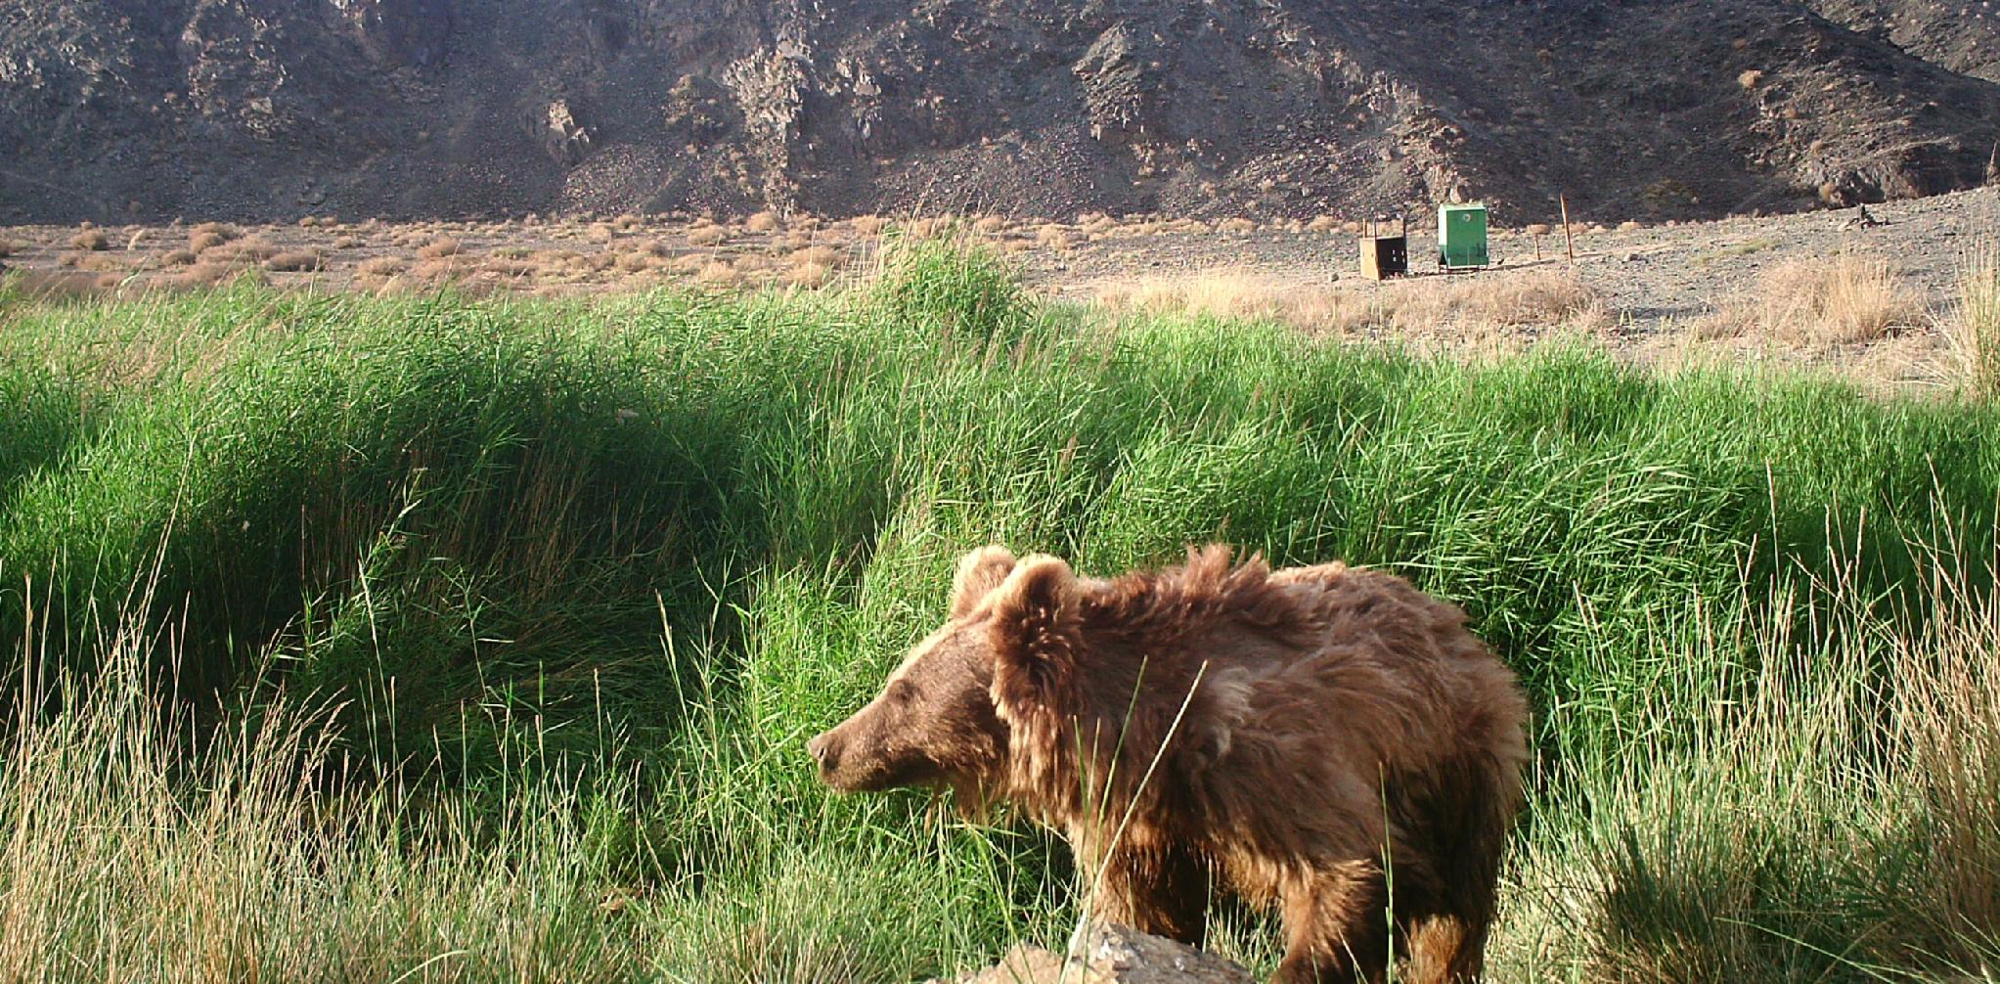
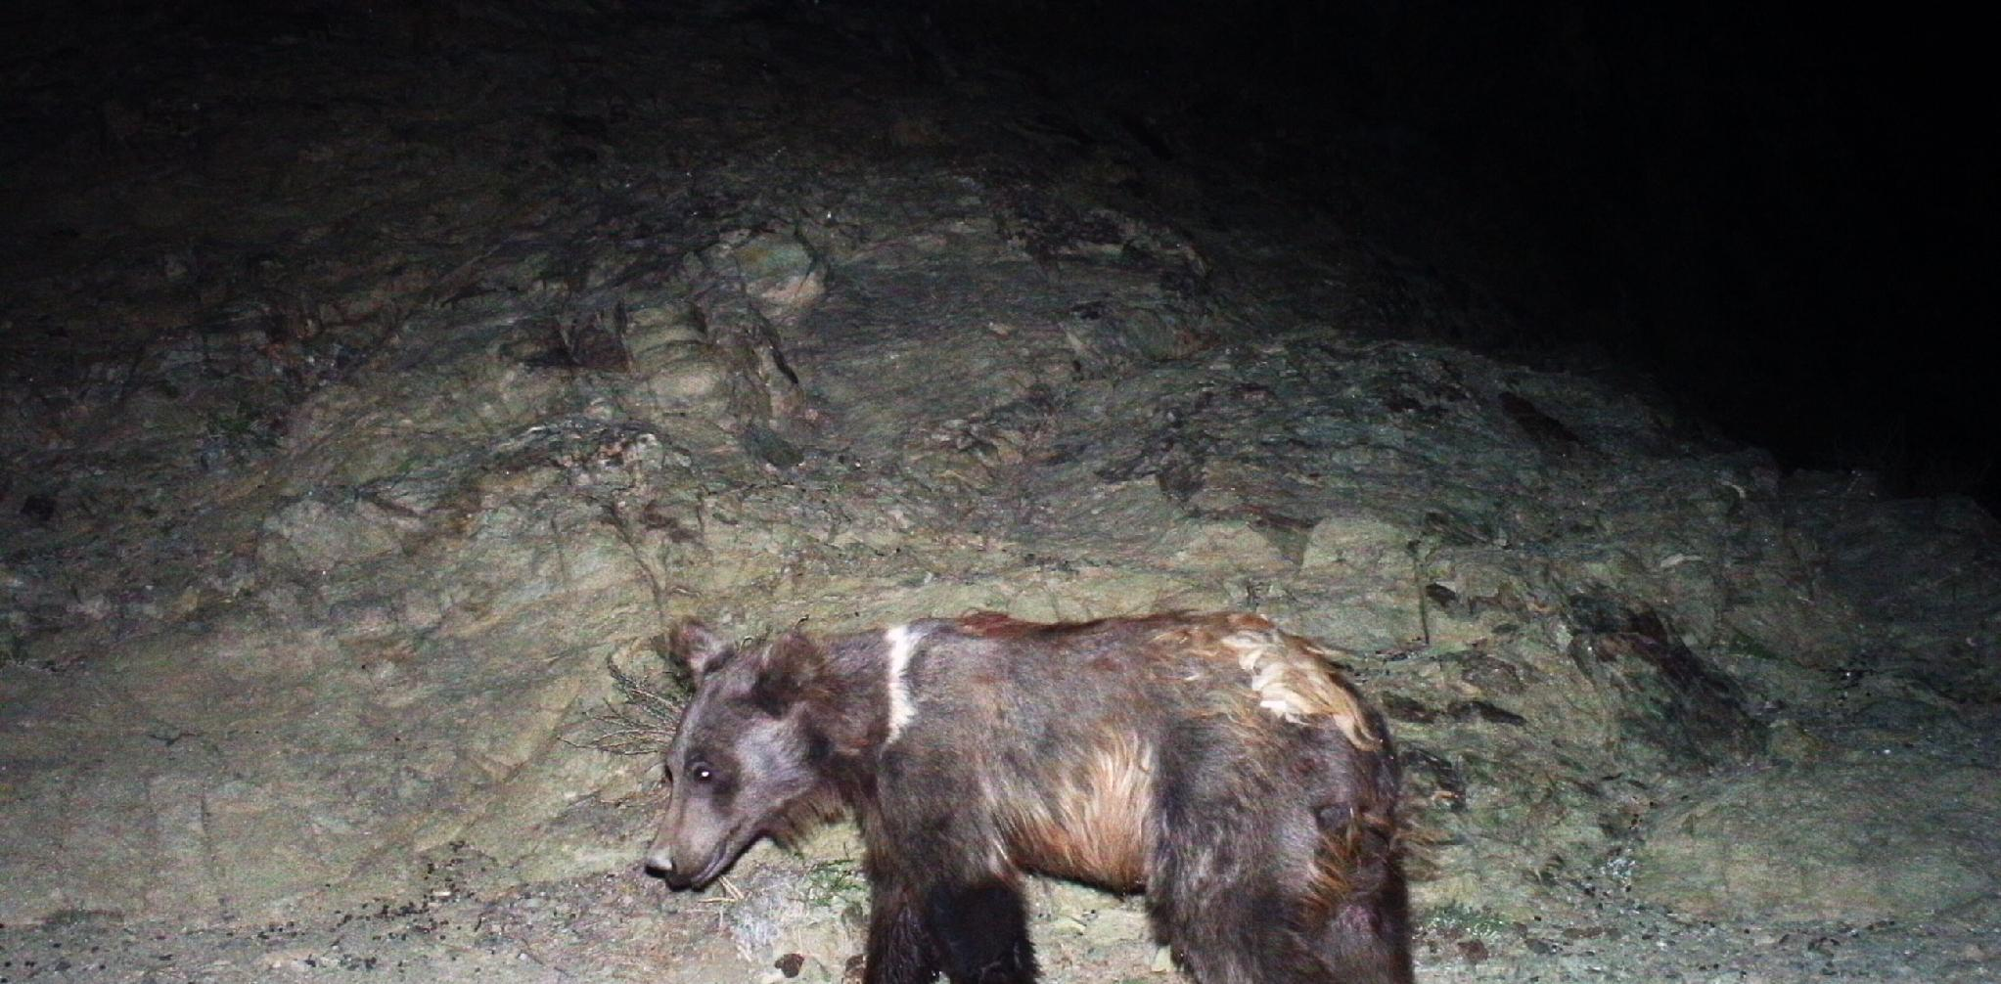
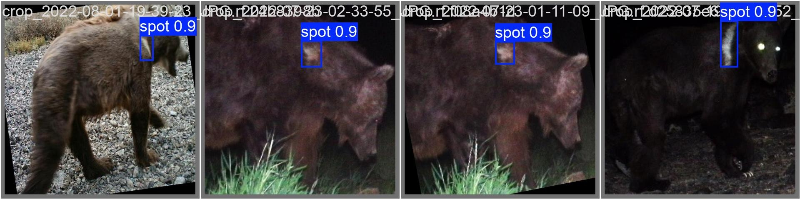
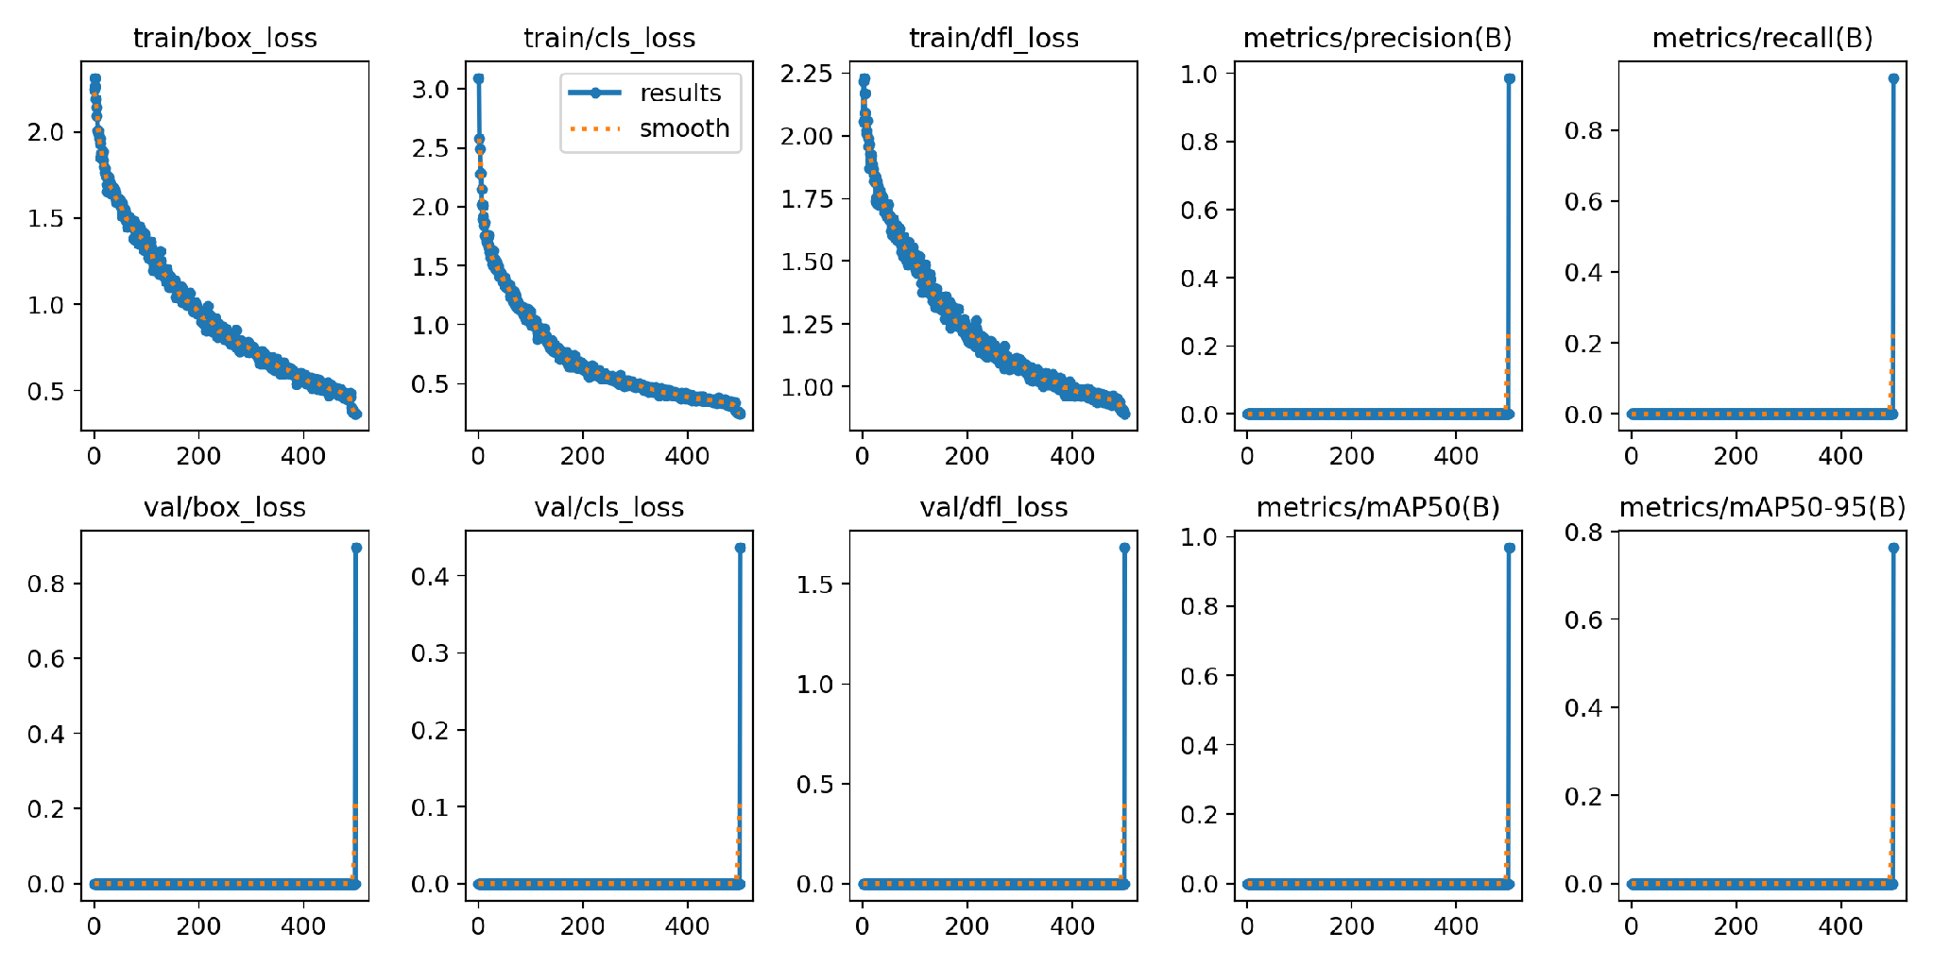
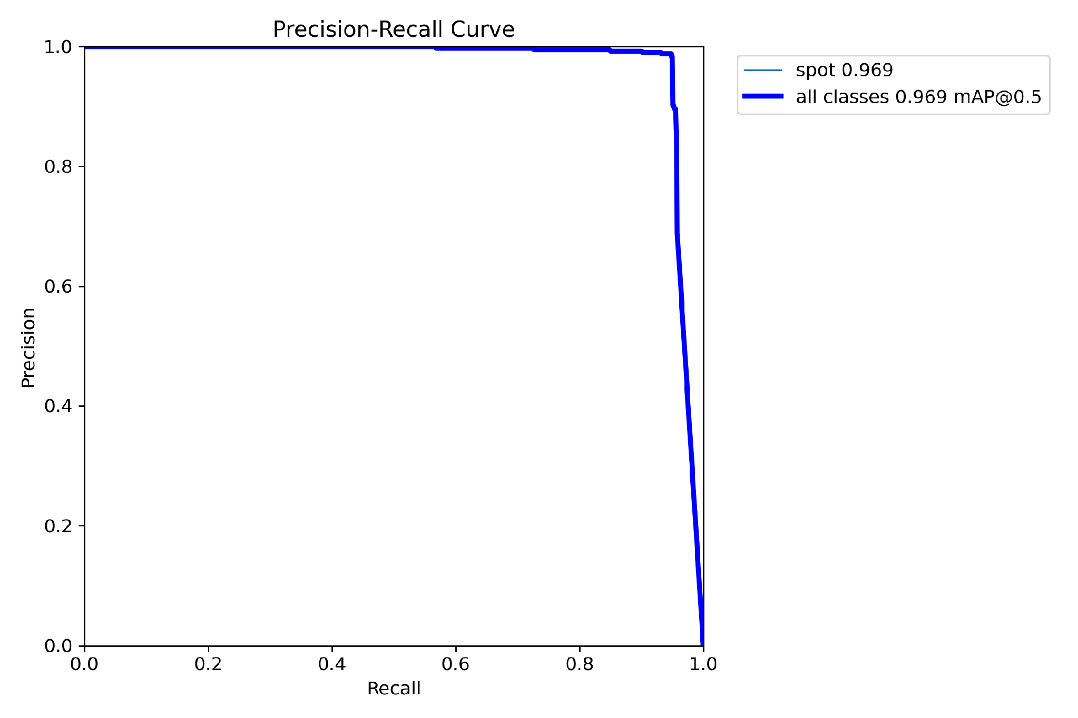
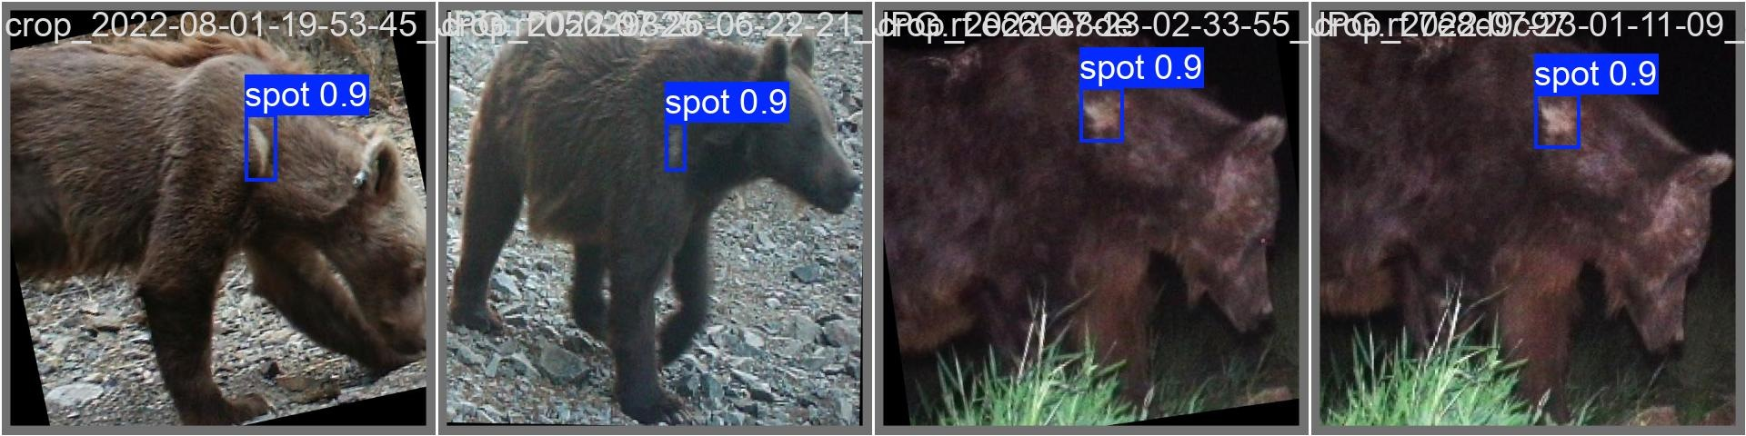
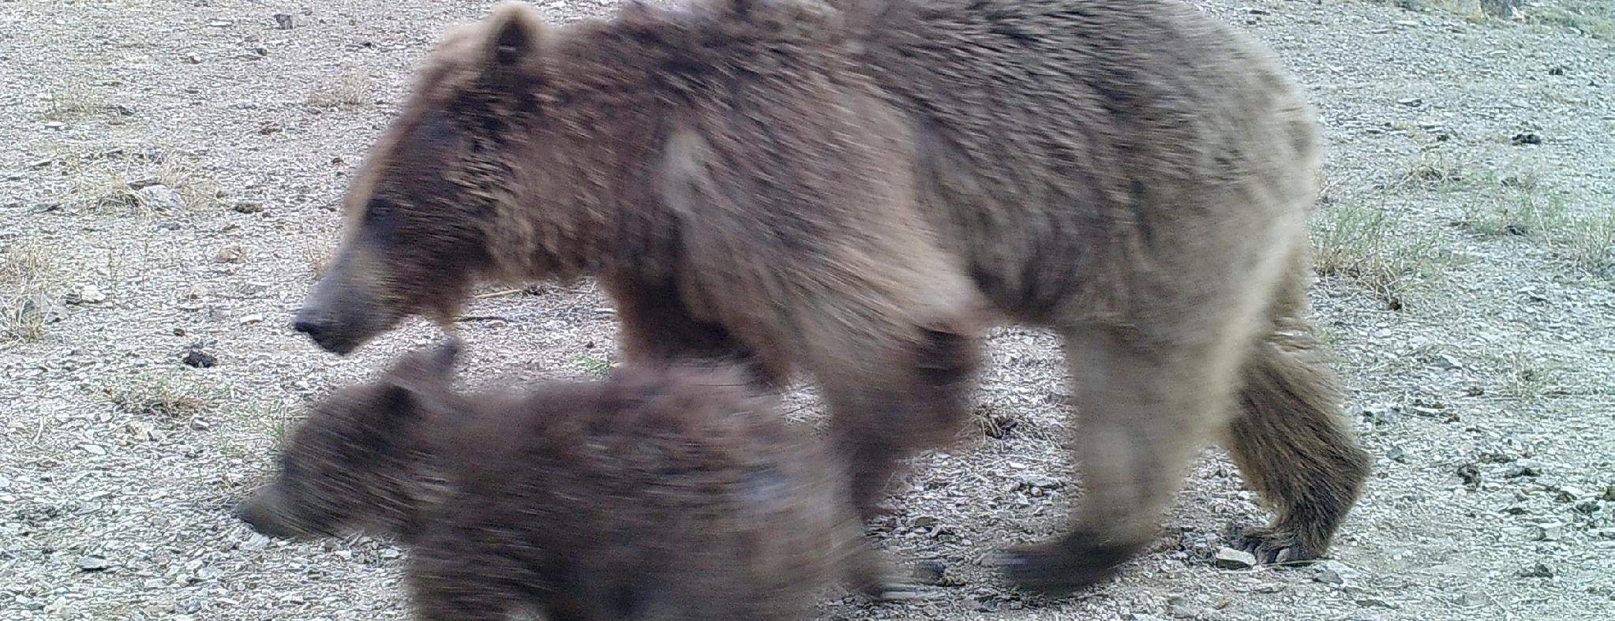
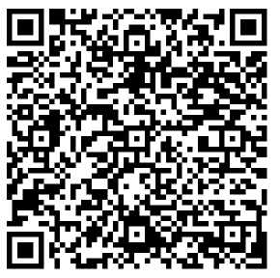
HIGHER ENGINEERING EDUCATION DEVELOPMENT (M-JEED) PROJECT
MONGOLIA–JAPAN JOINT RESEARCH – BUSINESS PARTNERSHIP 2026
17 September 2026 | Ulaanbaatar, Mongolia
RESEARCH
FIELD
AI- AND COMPUTER-VISION-BASED INDIVIDUAL RE-IDENTIFICATION OF THE GOBI BEAR FOR POPULATION AND MOVEMENT MONITORING
ICT / AI
Computer Vision
Wildlife Monitoring
Keywords: computer vision • YOLOv8 • re-identification • feature embedding • clustering • wildlife monitoring
Mongolian University of Science and Technology, School of Information and Communication Technology • Institute of Biology, Mongolian Academy of Sciences (Mammalian Ecology Laboratory) • Tokushima University, STIR-Lab
MONGOLIAN TEAM LEADER
JAPANESE COUNTERPART
B. Namjildorj, Ph.D. — Senior Lecturer, Project Leader
Mongolian University of Science and Technology (MUST), School of Information and Communication Technology, Department of Information Technology
namjildorj@must.edu.mn | +976 9908 1572 | MUST Building VI, Room 312
Team: S. Ulziibayar, Ph.D. • A. Altangerel, Ph.D. • B. Zolzaya, Ph.D. • N. Battogtokh (Institute of Biology, MAS) • E. Munkhsukh (Ph.D. Candidate)
Tokushima University — STIR-Lab
AI · Computer Vision · Data Science
Joint algorithm development • AI model optimization and evaluation • Methodological consultation • PhD co-supervision • Joint research publications
1. PROBLEM & OBJECTIVE
2. APPROACH & COLLABORATION
The Mazaalai (Gobi bear) is a uniquely desert-adapted bear found only in Mongolia’s Great Gobi A Strictly Protected Area. With an estimated population of only 20–30 individuals, it is at high risk of extinction.
Because GPS collars cannot be deployed on every individual, population monitoring relies heavily on camera-trap images collected at 13 water sources and oases.
Manually reviewing and identifying individuals across thousands of images is time-consuming and labor-intensive, while variations in lighting, viewing angle, and appearance make reliable identification challenging.
OBJECTIVE:
To develop an AI-based individual re-identification system that identifies Gobi bears from their distinctive shoulder spot patterns in camera-trap images, enabling automated estimation of population size and movement between water sources and oases.
Data: 4,916 camera-trap images collected from 13 water sources in 2018, 2020, 2022, and 2024 → 1,392 images containing Gobi bears → 397 images with clearly visible shoulder spots (left: 194 / right: 203; long coat: 195 / short coat: 202).
Annotation & Training: 427 images were annotated using Roboflow, and the YOLOv8x model was trained for 500 epochs.
Collaboration: MUST-SICT — algorithm development, model training, and evaluation; MAS Institute of Biology — field camera deployment, data collection, and ecological expertise; Japanese counterpart — methodological consultation and joint publication.
PROCESSING PIPELINE
YOLOv8x
Detect
SAM
Segmentation
CNN / SLIP
embedding
UMAP
Reduce
HDBSCAN
K-Means
ID of individuals
Gobi National Park (Area A), water point
White spot on the shoulder — the natural “ID” of the soul
YOLOv8x model spot detection (spot, confidence 0.9)
3.KEY RESULTS, TECHNOLOGY / PRODUCT
KEY RESULTS
High-accuracy spot detection: YOLOv8x successfully detected distinctive shoulder spots in camera-trap images, achieving mAP@0.5 ≈ 0.99.
Curated re-ID dataset: From 4,916 raw images, 397 high-quality images with clearly visible shoulder spots were selected to form a reference dataset.
Structured for individual re-identification: The dataset was categorized by left/right body side and long/short coat, providing a structured basis for subsequent re-ID analysis.
Improved processing efficiency: Automated image screening and spot detection substantially reduced the time required to process seasonal camera-trap data, from weeks to hours.
OUTPUTS
1 article in a journal registered in WoS / Scopus • 1 copyright certificate • 1 preliminary defense of a doctoral dissertation • presentation at an international conference.
TECHNOLOGY / PRODUCTS - “Individual -ID”
A computer vision–based re-identification pipeline identifies individual Gobi bears from camera-trap images using distinctive shoulder spot patterns, supporting automated population and movement monitoring.
Detection → Segmentation → Feature Embedding → Clustering → Individual ID
Output: individual ID catalog, frequency of migration between water points, assessment of fatness, population estimates.
Development level: TRL 3-4 - laboratory prototype, tested on real field data.
YOLOv8x Training Performance (500 Epochs, 427 Annotated Images)
Precision–Recall curve (spot classification)
YOLOv8x Spot Detection Performance
mAP@0.5 ≈ 0.99
Model Training
427 annotated images in Roboflow • 500 epochs
Reference Re-ID Dataset
397 images • Left: 194 / Right: 203
Spot detection results in different conditions (day, night, IR) of the field camera
4. APPLICATIONS & BUSINESS POTENTIAL
APPLICATIONS
Wildlife monitoring and population assessment: supporting government agencies, protected-area administrations, and the Mongolian Academy of Sciences in monitoring rare species, estimating populations, and preparing seasonal reports.
International conservation programs: supporting initiatives and open-data platforms of organizations such as WWF Mongolia, Denver Zoo, IUCN, and UNESCO.
Cross-species re-identification: adapting the proposed methodology to other rare wildlife species, including snow leopard, argali, khulan, takhi, and wild Bactrian camel.
Biodiversity and ESG monitoring: providing data-driven evidence for environmental impact assessments of mining and infrastructure projects.
Education and research: providing real-world case studies in computer vision and data analytics, as well as research topics for graduate and doctoral students.
BUSINESS POTENTIAL
Wildlife Monitoring as a Service: automated processing of camera-trap data to provide individual identification and population monitoring reports.
Technology Transfer & Licensing: development of integrated solutions combining the proposed AI system with edge-AI and camera technologies for on-device wildlife detection.
Startup & International Funding: opportunities to establish a spin-off/startup and jointly participate in international grants and pilot projects, including JICA, JST, and GEF.
ESG & Biodiversity Monitoring: data-driven wildlife monitoring solutions for mining, energy, and infrastructure companies to support biodiversity assessment and ESG reporting.
TARGET USERS & PARTNERS
Ministry of Environment, Administration of Specially Protected Areas
Academy of Sciences, Institute of Biology; university researchers
WWF Mongolia · Denver
Zoo · IUCN · UNESCO
Mining and energy companies — ESG and biodiversity reporting
Other rare animals: leopard, argali, kulan, and mongolian zebra
International grants, pilot projects: JICA, JST, GEF
Mazaalai mother and cubs — field camera footage, Gobi National Park
5. PARTNERSHIP, IMPACT & NEXT STEPS
WE ARE LOOKING FOR :
☑ Joint R&D ☑ Pilot testing ☑ Technology transfer ☑ Co-supervision of PhD student ☐ Licensing / Investment
IMPACT
Environmental: Enables data-driven decision-making for the conservation and monitoring of rare and endangered wildlife.
Social: Strengthens sustainable collaboration among MAS, MUST, and international researchers, while promoting public awareness of wildlife conservation.
Human Resource Development: Builds AI research capacity by training PhD and Master's students and early-career researchers in AI and computer vision.
Economic: Significantly reduces the time and cost of manual processing of large-scale camera-trap data.
4,916 → 397
Images → Reference Dataset
15 month
2027.01 – 2028.04
20–30
Estimated Remaining Population
NEXT STEPS
2027.01 – 03
Dataset preparation and YOLO model retraining
2027.04 – 06
Accuracy evaluation, re-ID method testing, and transition to video-based camera monitoring
2027.07 – 09
Collection of new field data and re-identification of individual Gobi bears
2027.10 – 12
Preparing articles for international journals and defending a doctoral degree
2028.01 – 04
Final reporting, methodology dissemination, and intellectual property registration
6. CONTACT & BUSINESS MATCHING
Team Leader: Batbaatar NAMJILDORJ, Ph.D | Institution: SHUTIS, School of Information and Communication Technology, Information Technology Department
E-mail: namjildorj@must.edu.mn | Phone: +976 9908 1572 | Address: SHUTIS Building VI, No. 312, Ulaanbaatar, Mongolia
Partner Institution: Academy of Sciences, Institute of Biology — Laboratory of Mammal Ecology (N. Battogtoh)
POWERPOINT TEMPLATE 40 × 90 cm (1:2 SCALE) → PRINT AT 200% = 80 × 180 cm

