Slide 1

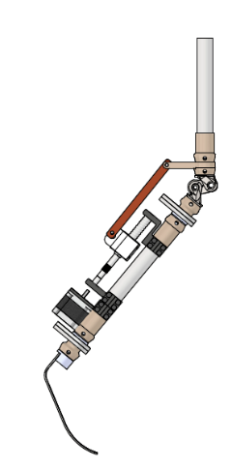
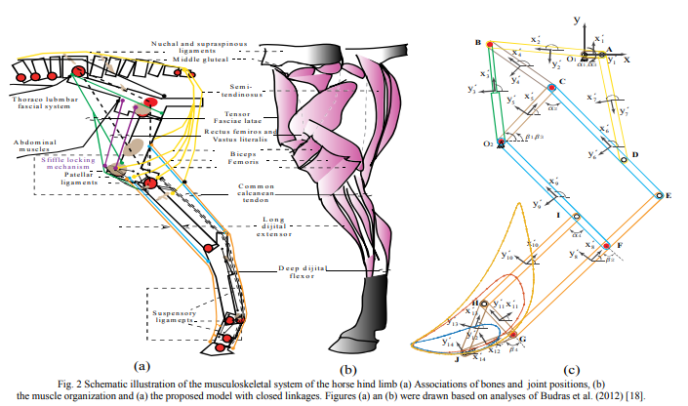
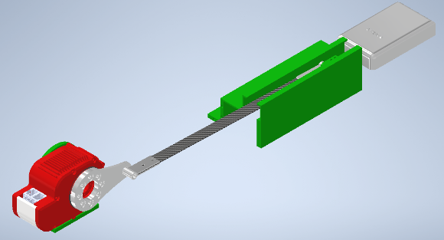
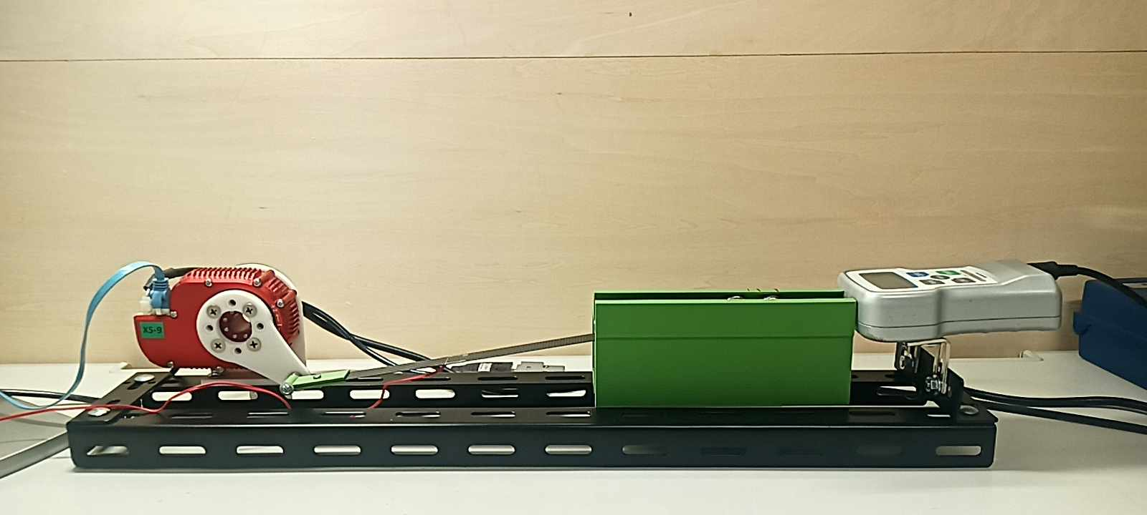
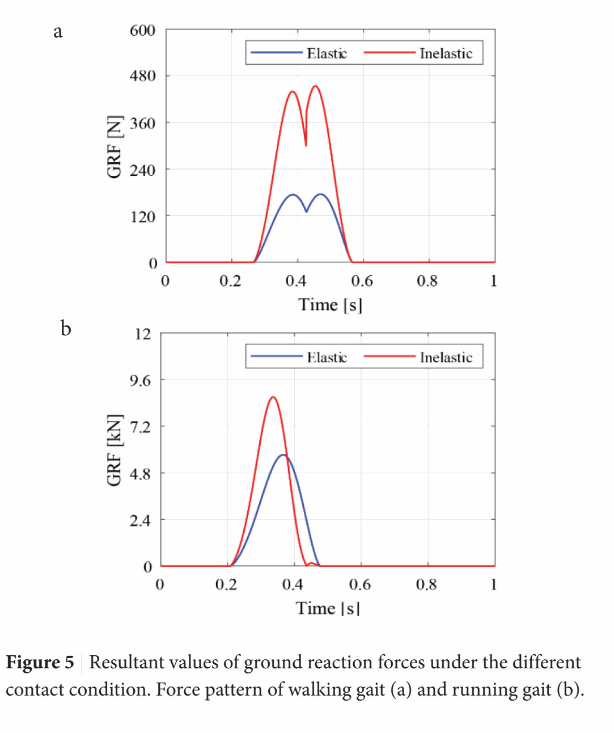
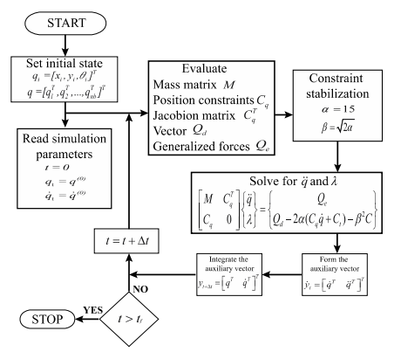
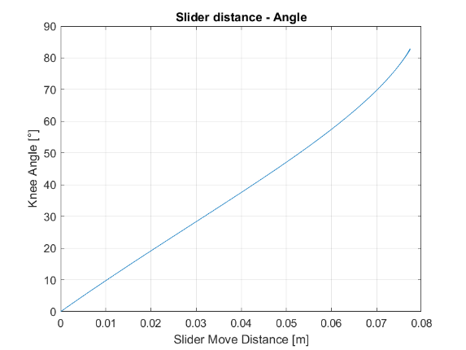
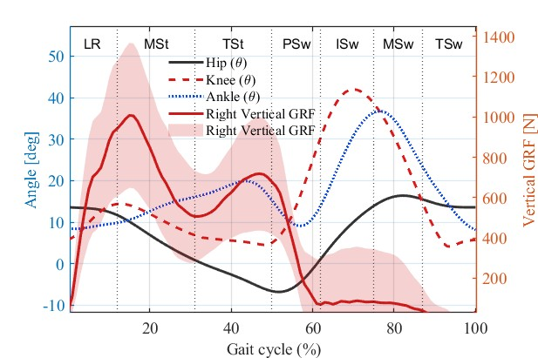
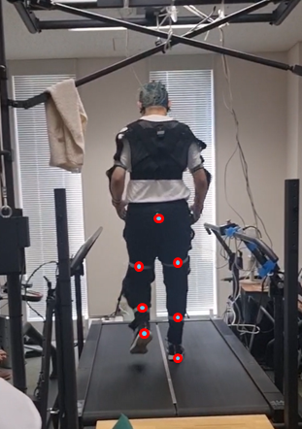
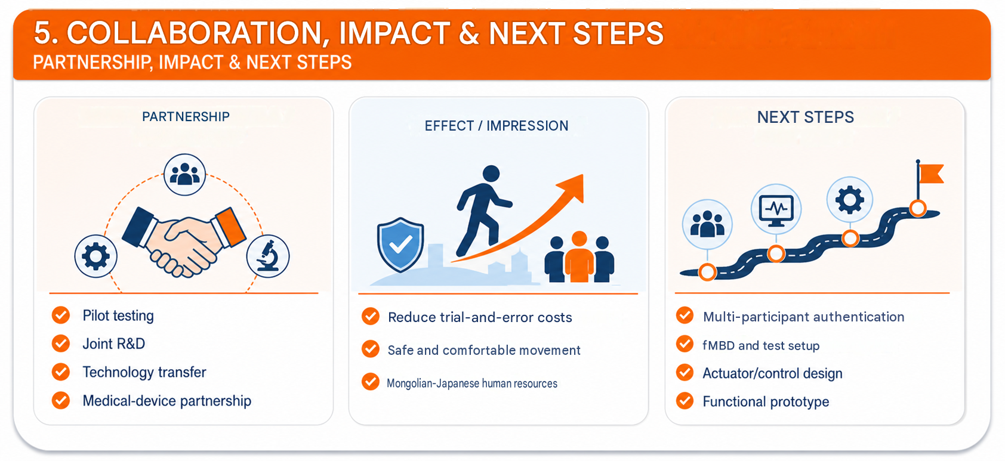

RESEARCH FIELD
The development of industrial, service and intelligent systems based on advanced technologies
Automation, system engineering
J23A16-4
Intelligent robotics application for industry and service
Keyword : Robotics, Dynamics, MBD, Legged robotics
MUST – SMET • Kyushu Institute of Technology • MJEED–JICA J23A16
MONGOLIAN TEAM LEADER
JAPANESE COUNTERPART
B. Otgonbayar , Professor
Mongolian University of Science and Technology, SICT
Hiroki Kishikawa , Professor
University of Tokushima
SUB-COORDINATOR
JAPANESE SUB- COUNTERPART
E. Naranbaatar, Ph.D
Mongolian University of Science and Technology, SMET
Hiroaki Wagatsuma, Professor
Kyushu Institute of Technology, Life Science and Systems Engineering
1. PROBLEM & OBJECTIVES
2. METHODS & COLLABORATION
• Problem : artificial with knees user walking load , energy power spending high .
• Inactive artificial knee under load accustomed incompatible ; active system weight , energy power expensive .
• Objective : MBD, fMBD /ANCF, flexible contact and real walking data together energy power economical mechanism indicator to establish .
• Base : B.Dondogjamt’s closed link and flexible MBD with contact .
• Model : ANCF elastic body + contact power + artificial knee slider-link mechanism .
• Test : CFRP material ; IMU 100 Hz + treadmill GRF 1000 Hz.
• Processing : MATLAB, DAE, Runge- Kutta Gill, cross-correlation, Butterworth, gait-cycle normalization.
3. KEY RESULTS, TECHNOLOGY / PRODUCT
KEY RESULTS
• Flexible contact GRF​ 61.35% reduction in walking and 34.22% reduction in running ( B. Dondogjamts , 2021).
• 2 peaks for walking , 1 peak for running and damping​ caused period difference determined .
• CFRP testing compression The force reaches 1.4 N. even though it is stable , deformation continued .
• Knee angle –slider transition relationship linear not ; critical movement limits by MBD defined .
• Real gait : cycle 1.05 s; stance 62%; swing 0.40 s; foot Height 0.22 m.
• GRF: impact ~1000 N, push-off ~800 N (80%); hip 0–40°, knee 0–50°, ankle −10°...+20°.
TECHNOLOGY / PRODUCT
• Biological contact → flexible material → artificial knee → real walking data connected calculation design flow .
• 4 studies seed result combined mechanism parameters , load , energy evaluation .
4. APPLICATIONS & BUSINESS POTENTIAL
PRACTICAL APPLICATIONS
• Artificial knee , orthosis / exoskeleton , rehabilitation fix walking evaluation .
• Sports biomechanics , foot robots , users adjusted help device .
BUSINESS POTENTIAL
• Simulation-based mechanism design and verification service.
• Hospital , rehabilitation fix center , prosthesis pilot with manufacturer .
• 3D printing , technology transmission , license , joint product .
PARTNERSHIP, IMPACT & NEXT STEPS
6. CONTACT & BUSINESS MATCHING
Sub coordinator: E.Naranbaatar| Lead Researcher: B.Dondogjamts, Ch.Purevdorj,
Japan Counterpart: Hiroaki Wagatsuma, Kyutech

