Slide 1





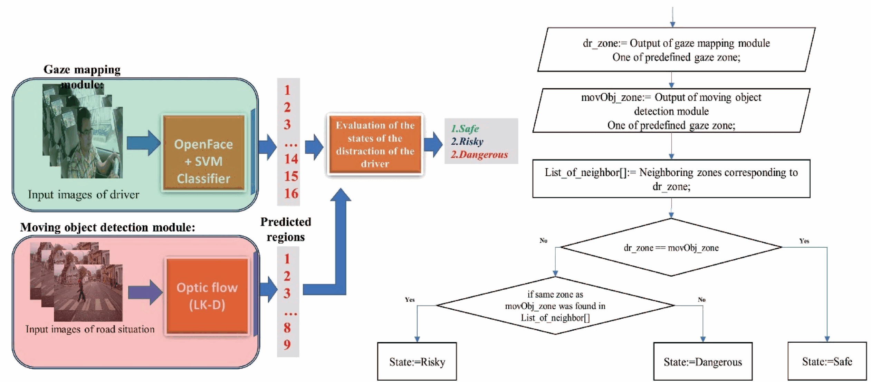
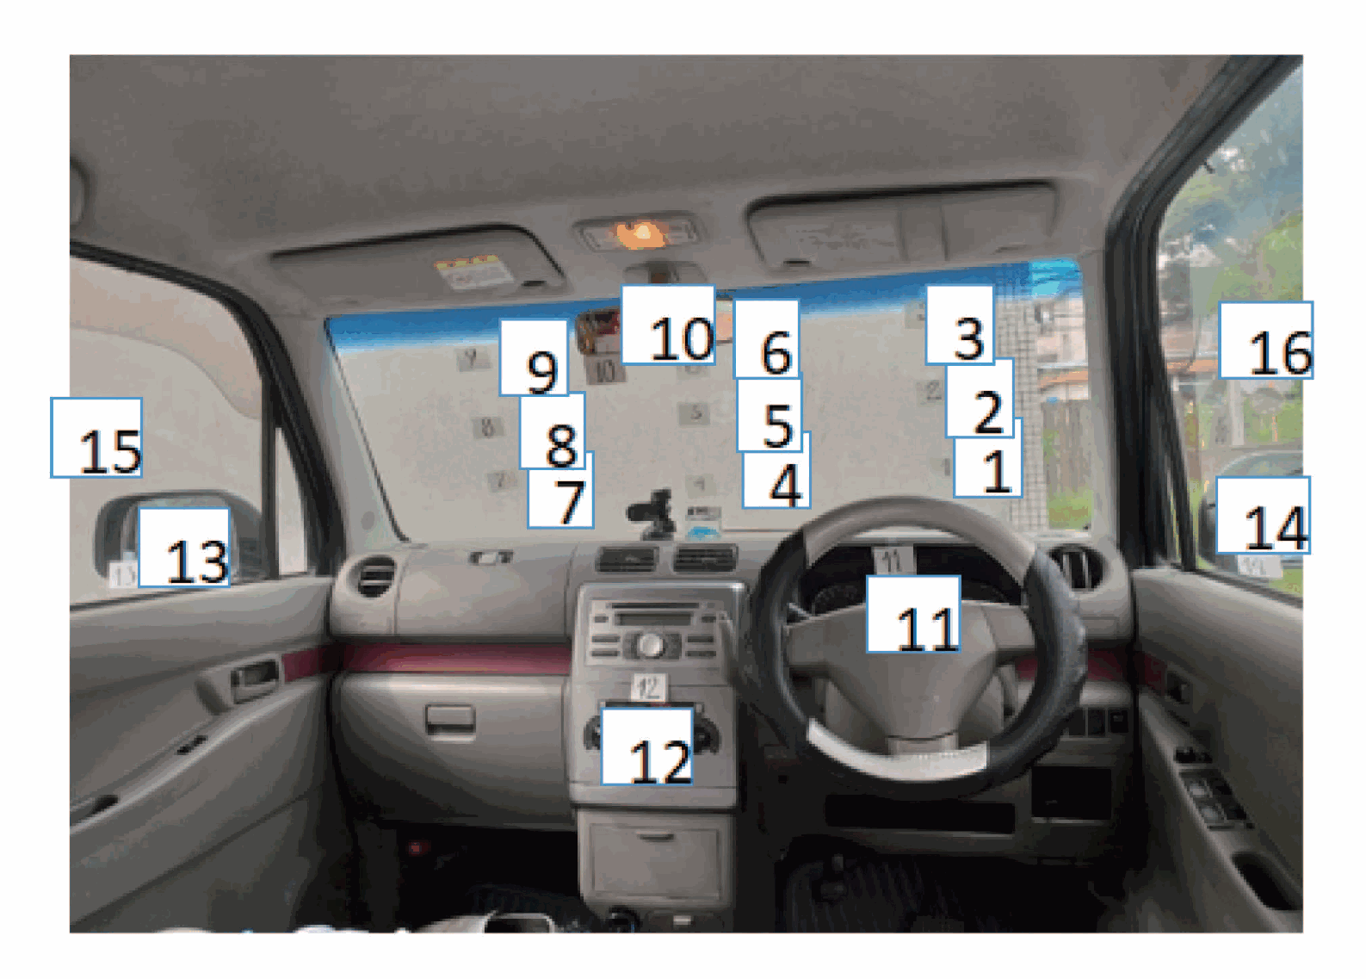
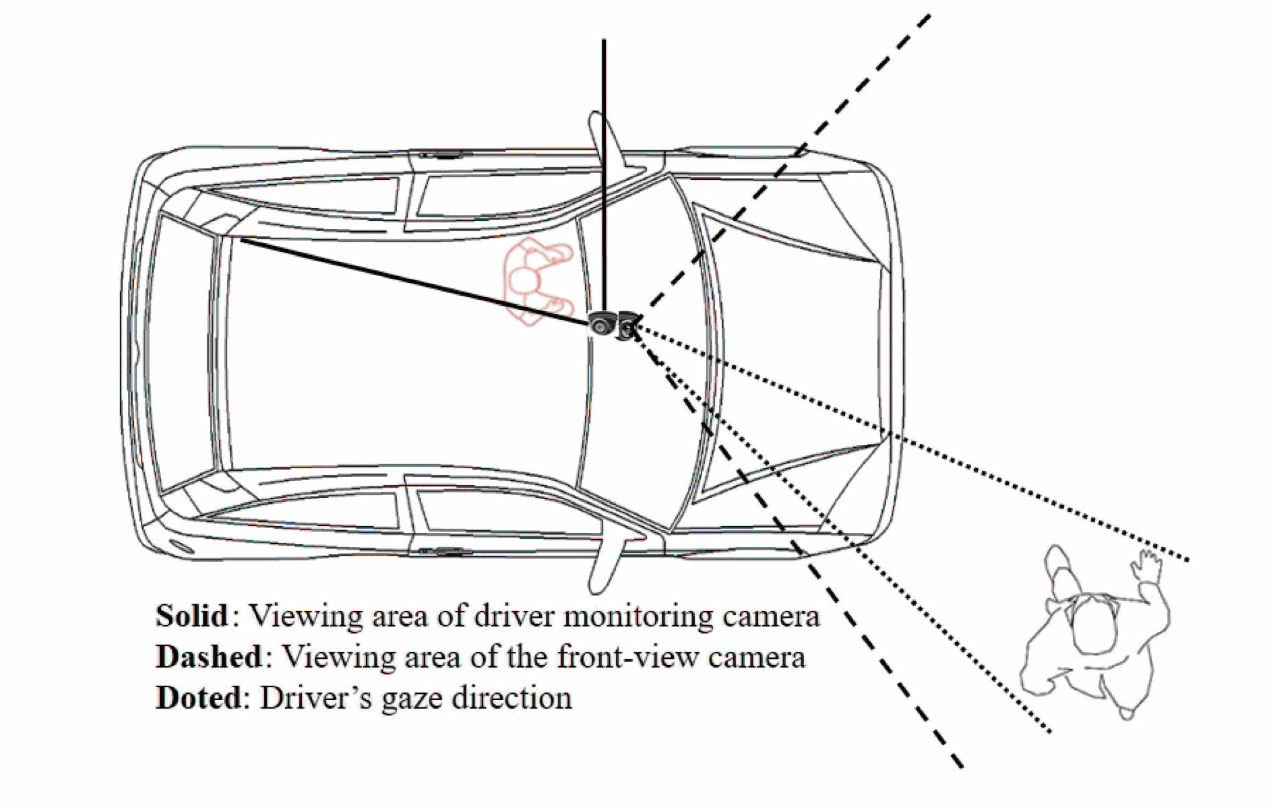
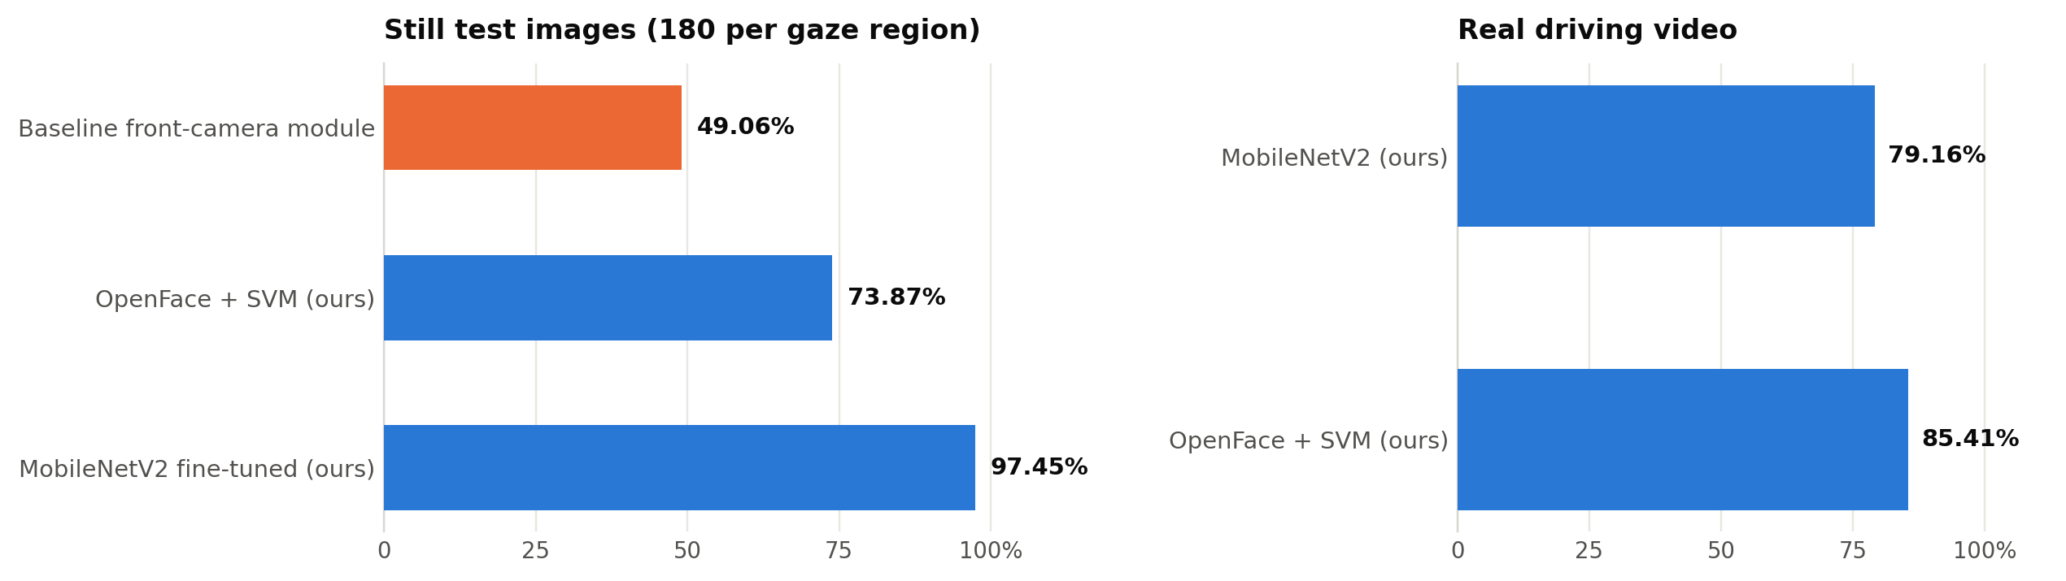
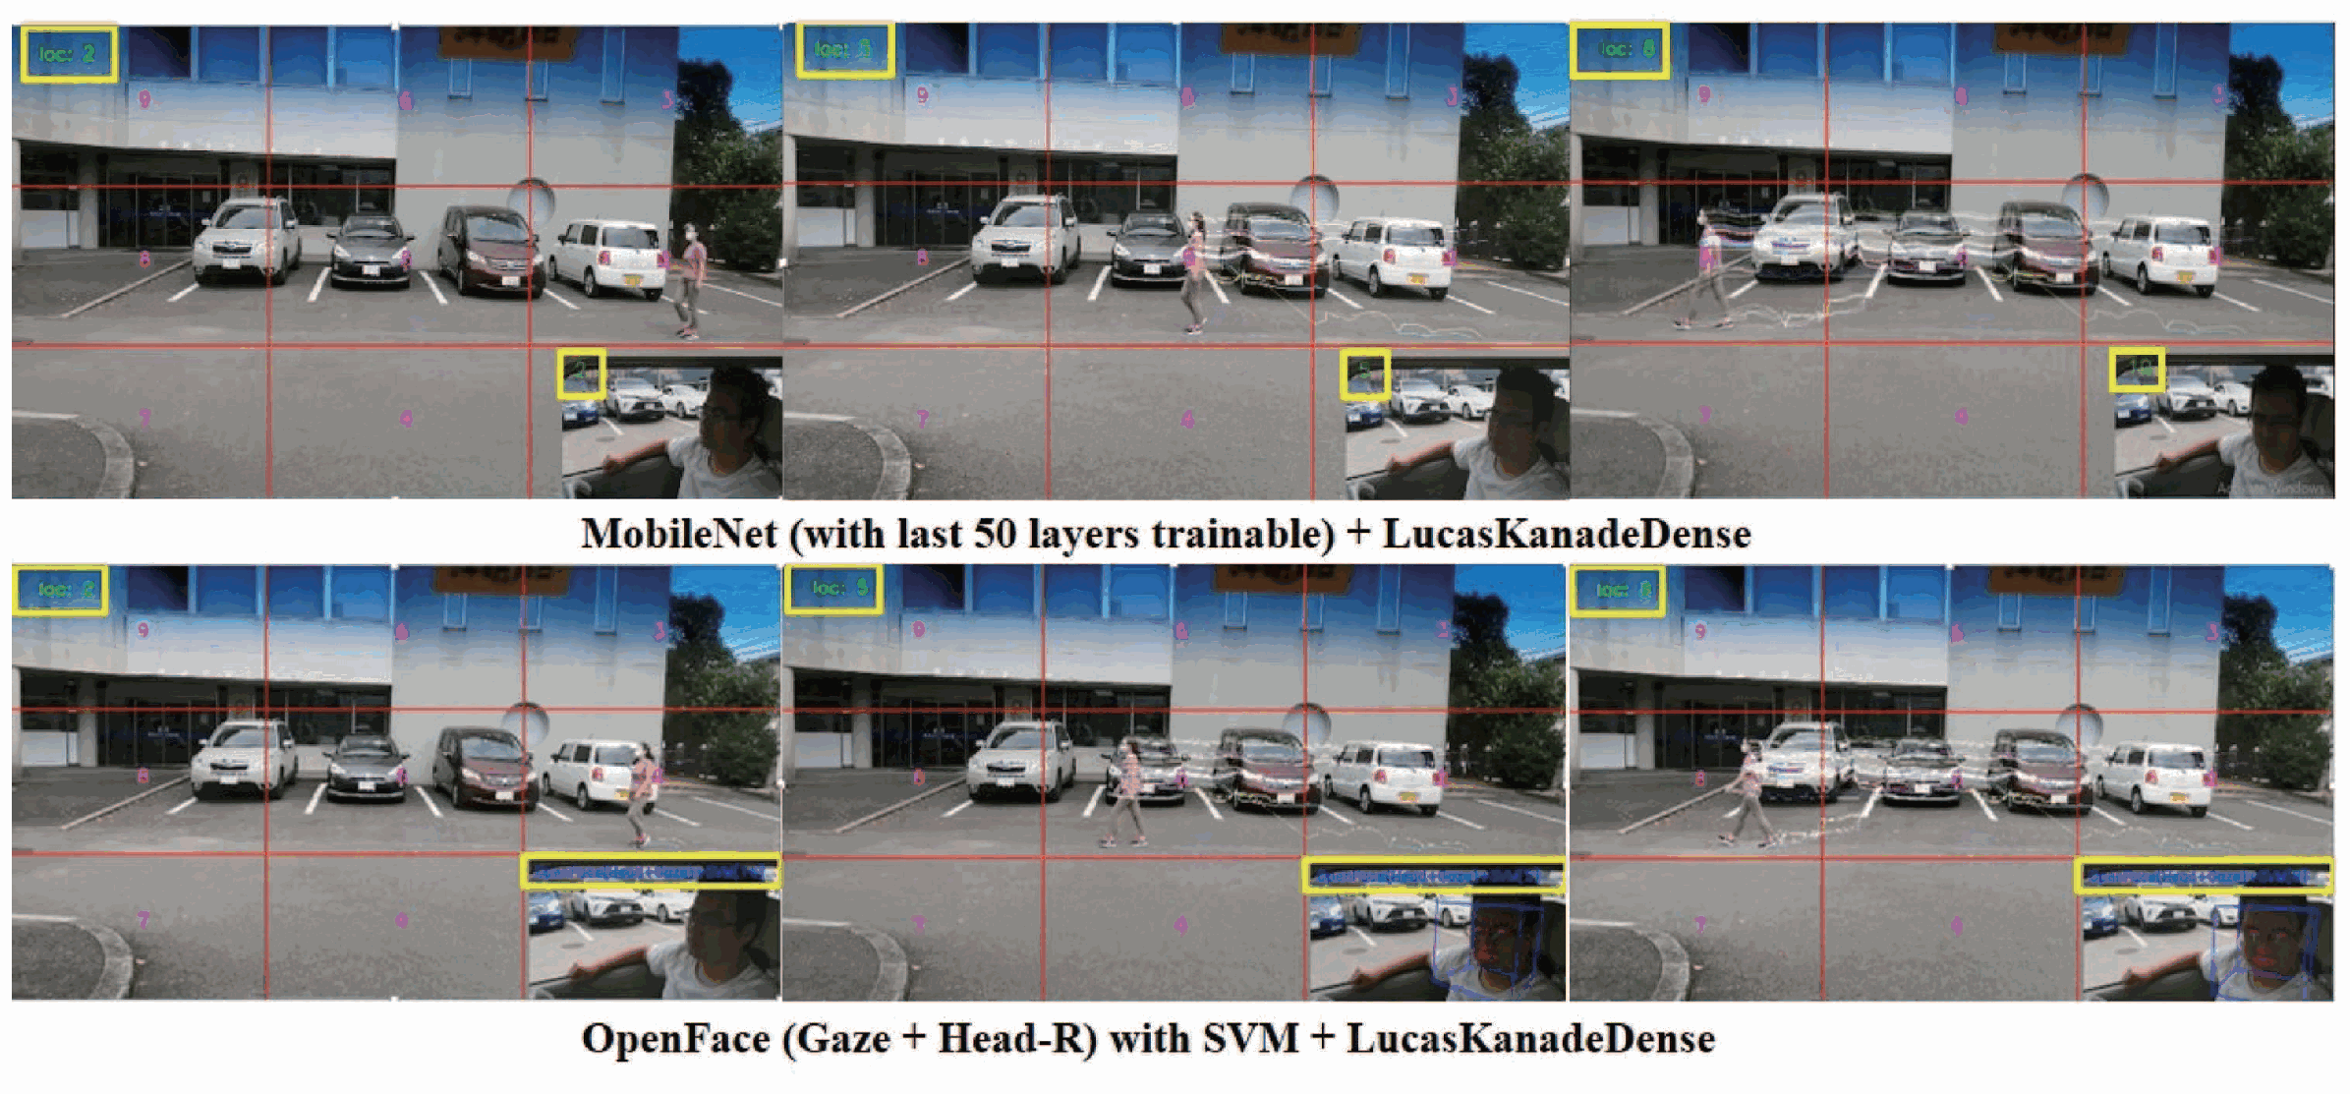
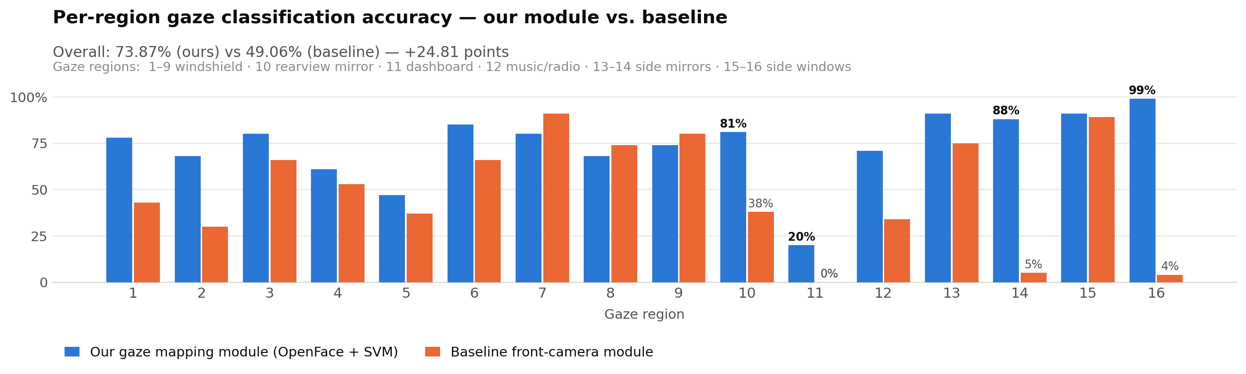
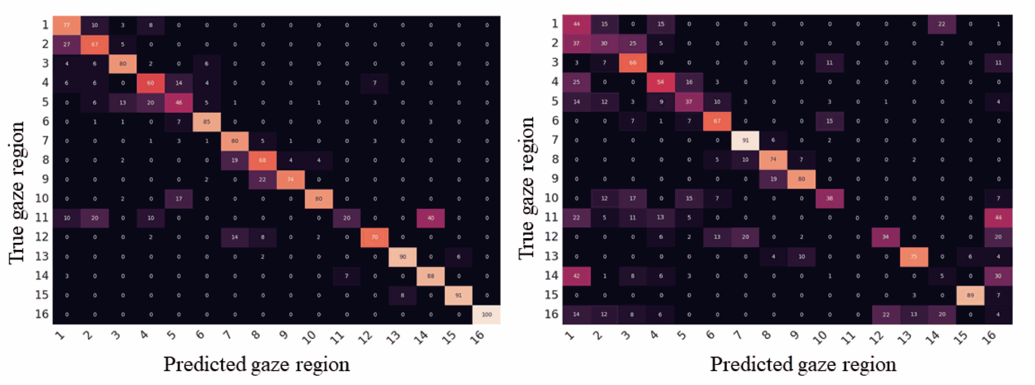
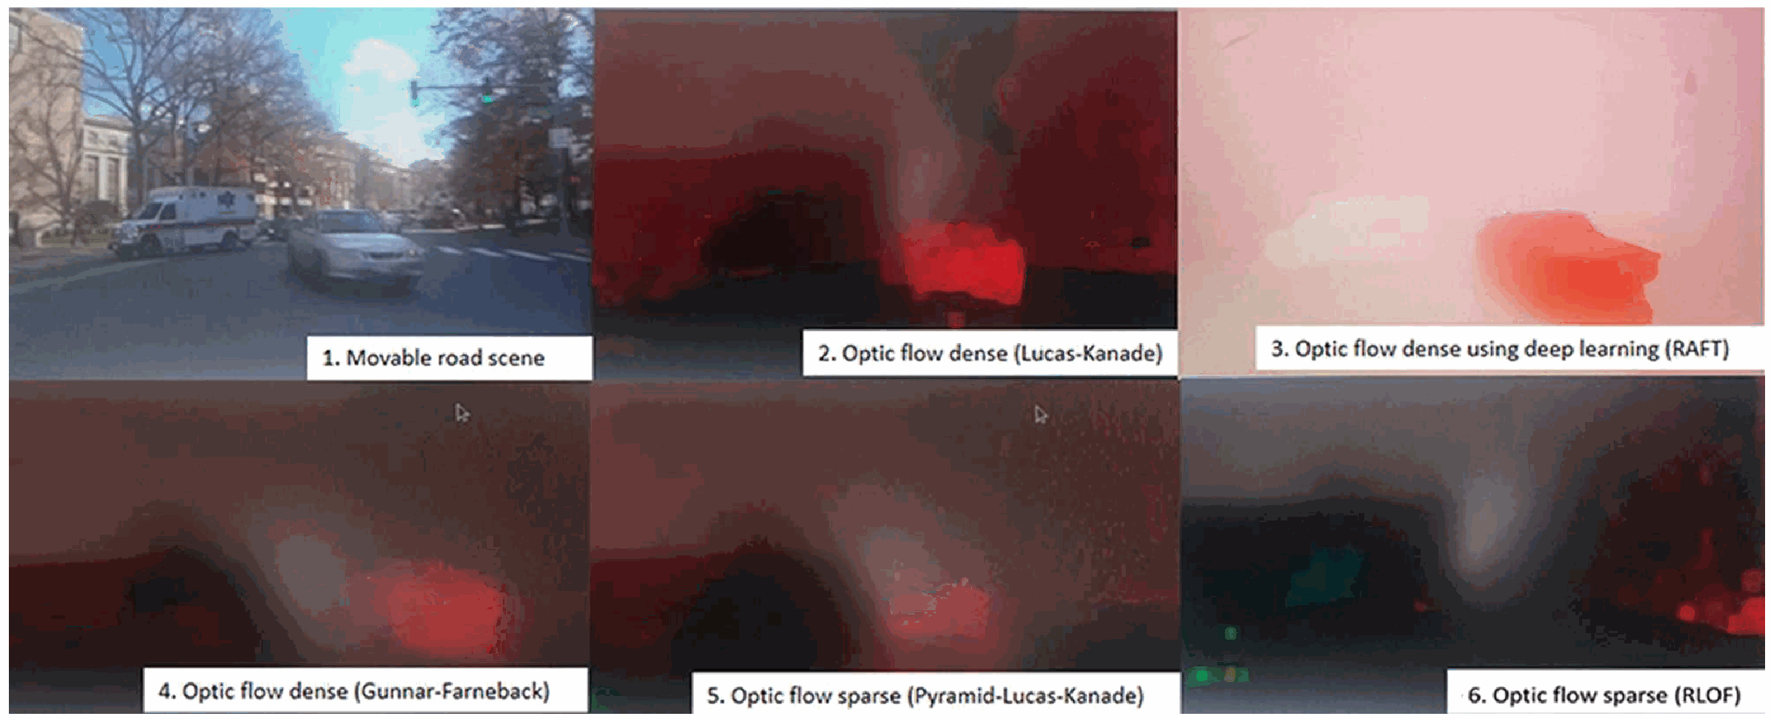
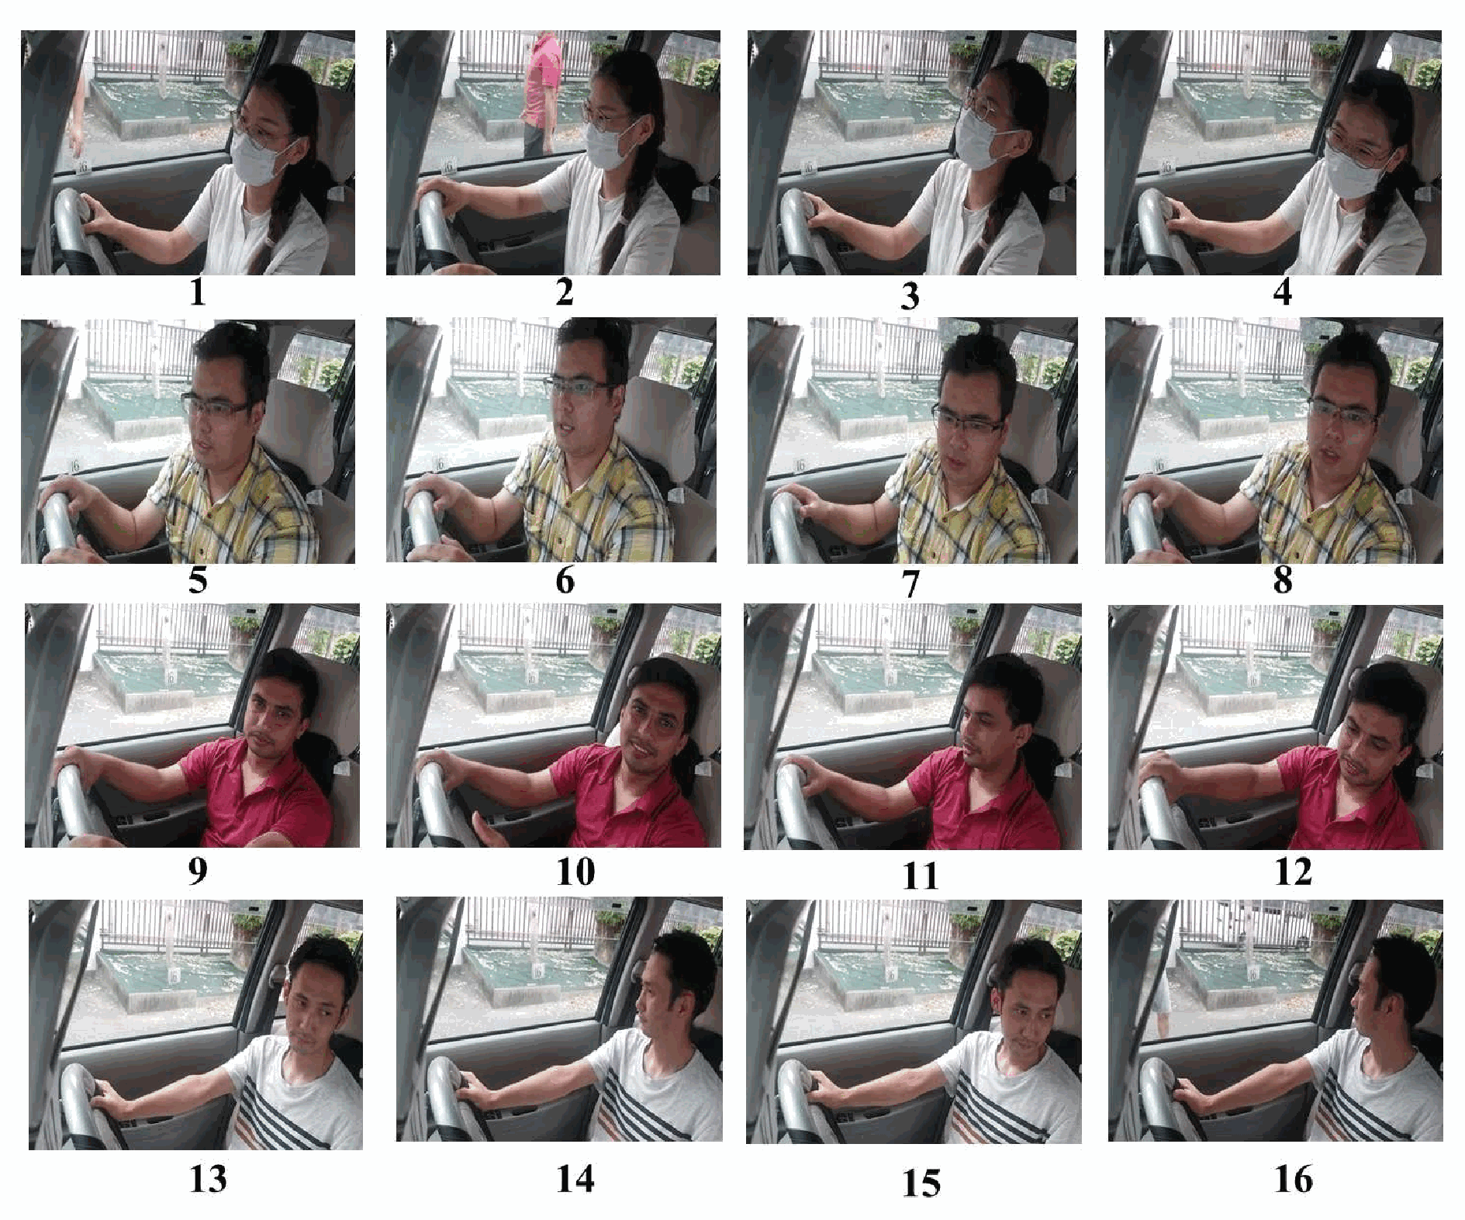


M-JEED
LOGO
MINISTRY
LOGO
EN_PosterHead.png
HIGHER EDUCATION PROJECT IN ENGINEERING AND TECHNOLOGY
MONGOLIA–JAPAN JOINT RESEARCH AND BUSINESS PARTNERSHIP – 2026
September 17, 2026 | Ulaanbaatar, Mongolia
Research Priority Area:
Information and Communication Technology — Artificial Intelligence
A STUDY ON THE DEVELOPMENT OF SMART SYSTEMS FOR INDUSTRIAL, SERVICE, AND DOMESTIC APPLICATIONS USING ADVANCED TECHNOLOGIES
Detection of a Driver’s Visual Distraction Using Dual Cameras
A low-cost AI safety module for transport, logistics and public-service vehicle fleets
Keywords: visual distraction · gaze mapping · moving object detection · gaze region · dual dash camera · fleet safety
MONGOLIAN PROJECT TEAM LEADER
JAPANESE PROJECT TEAM LEADER
Professor Stephen Karungaru, Ph.D.
Tokushima University, Dept. of Information Science and Intelligent Systems
Email: karunga@is.tokushima-u.ac.jp
Professor Altangerel Ayush, Ph.D.
MUST, School of Information and Communication Technology / Dept. of Information Technology
Email: a.altangerel@must.edu.mn
RESEARCH TEAM MEMBER
Ulziibayar Sonom-Ochir, Ph.D.
MUST, School of Information and Communication Technology / Dept. of Information Technology
Email: ulziibayar@must.edu.mn
RESEARCH TEAM MEMBER
Professor Kenji Terada, Ph.D.
Tokushima University, Dept. of Information Science and Intelligent Systems
Email: terada@is.tokushima-u.ac.jp
1. PROBLEM & RESEARCH OBJECTIVES
2. METHODOLOGY & COLLABORATION
WHY DRIVER DISTRACTION MATTERS
1. Over 1.3 million people die on the world’s roads every year (WHO); distraction is among the leading causes.
2. Eye trackers and wearable sensors are expensive, intrusive and tiring for professional drivers.
3. Existing systems watch only the driver and ignore what is happening on the road ahead.
4. Looking away is not itself dangerous — the risk depends on where the hazard actually is.
5. Mongolian fleet operators have no affordable tool to measure driver risk objectively.
OBJECTIVES
1. Detect a driver’s visual distraction in real time using only a simple, low-cost dual dash camera.
2. Map the driver’s gaze onto 16 predefined in-cabin regions.
3. Detect moving road hazards and determine which region they appear in.
4. Combine both to classify every moment as Safe, Risky or Dangerous and warn the driver.
5. Deliver a lightweight module deployable on cameras fleets already own.
TWO-MODULE ARCHITECTURE
Gaze mapping: OpenFace v2.0 extracts gaze angle and head-pose R features; an SVM classifier assigns the driver’s gaze to one of 16 cabin regions. A fine-tuned MobileNetV2 was benchmarked against it.
Moving object detection: Lucas-Kanade dense optical flow on the front-view camera locates moving hazards and the region they occupy.
Decision layer: matching the two regions yields Safe, Risky or Dangerous.
DATASET
DriverGazeMapping (DGM): 12,425 labelled images from 4 volunteer drivers, captured morning, afternoon and night with a COOAU-D30-1080P dual dash camera.
COLLABORATION
MUST — dataset construction, algorithm design, evaluation and deployment toward Mongolian fleets.
Tokushima University — computer vision, machine learning, experimental design and international validation.
System structure and the Safe / Risky / Dangerous decision flow
16 predefined gaze regions
Dual-camera coverage: driver + road
3. KEY OUTCOMES, TECHNOLOGIES & PRODUCTS
KEY OUTCOMES
73.87% gaze-region accuracy — +24.81 points over the 49.06% baseline front-camera module.
85.41% accuracy on real driving video, 6.25 points above the MobileNetV2 variant, because head-pose features keep working when the face is not fully visible.
97.45% accuracy for fine-tuned MobileNetV2 on still test images (last 50 layers trained).
The baseline failed completely in regions 11, 14 and 16 (0–5%); our module still reached 20–99% there.
Lucas-Kanade dense detected moving hazards earlier and more reliably than the sparse method used by the baseline.
TECHNOLOGY
OpenFace v2.0 + multi-class SVM · MobileNetV2 · Lucas-Kanade dense optical flow · 16-region gaze model · three-state risk algorithm.
PRODUCT
A non-intrusive, low-cost software module that runs on an ordinary dual dash camera — no eye tracker, no wearable, no vehicle modification — and exposes a per-trip distraction record for fleet management systems.
Combined evaluation: gaze region vs. detected moving object
Confusion matrices — our module (a) vs. baseline (b)
PUBLICATION
U. Sonom-Ochir, S. Karungaru, K. Terada and A. Ayush, “Detection of Driver’s Visual Distraction Using Dual Cameras,” International Journal of Innovative Computing, Information and Control, Vol. 18, No. 5, pp. 1445–1461, October 2022. DOI: 10.24507/ijicic.18.05.1445
Optical-flow implementations
compared for real-time use
4. PRACTICAL APPLICATIONS AND BUSINESS OPPORTUNITIES
BUSINESS OPPORTUNITIES
1. Fleet safety management (transport & logistics): Turn the dash cameras a fleet already owns into a driver-risk monitor. Each trip yields an objective distraction record, so operators can act before a crash instead of investigating after one.
2. Taxi and ride-hailing platforms: Continuous, comparable safety scoring across thousands of contracted drivers, feeding driver ratings, incentive schemes and targeted retraining.
3. Insurance and leasing (usage-based pricing): Behaviour-based premium models and evidence-supported claims assessment — a new product line for insurers and a premium discount for safe fleets.
4. Aftermarket and camera vendors: The system is software only; it can be licensed as a firmware upgrade for dash cameras already sold in Mongolia, requiring no new hardware.
GOVERNMENT AND PUBLIC-SERVICE APPLICATIONS
5. Road-safety supervision (traffic police, public-transport authority): Objective distraction statistics from licensed bus and taxi operators support risk-based inspection, route-level intervention and evidence-based policy instead of self-reporting.
6. Driver licensing, training and occupational safety: Recorded gaze behaviour gives driving schools and OSH inspectorates measurable evidence of attention performance, and gives mining and construction employers a compliance record for haulage crews.
7. Crash investigation and smart-city data: Per-second Safe / Risky / Dangerous states help reconstruct incidents, and aggregated data identifies the road segments where drivers most often look away from a hazard.
Real drivers gazing at each of the 16 regions (DGM dataset)
PRIORITY DEPLOYMENT SECTORS
1. Long-haul freight and logistics fleets 2. Urban public-transport (bus) operators 3. Taxi and ride-hailing platforms 4. Mining and construction haulage 5. Traffic-police and road-safety agencies 6. Insurance, leasing and vehicle-rental companies
5. PARTNERSHIP, IMPACT & NEXT STEPS
PARTNERSHIP
Fleet operators and logistics companies — pilot vehicles, real driving data and operational feedback.
Insurance companies — joint design of a behaviour-based premium product.
Traffic police and the public-transport authority — regulatory framing, data governance and pilot routes in Ulaanbaatar.
Dash-camera vendors and integrators — firmware distribution and installed-base access.
Universities — MUST and Tokushima University: algorithm development, dataset expansion and independent validation.
EXPECTED IMPACT
Fewer crashes: drivers are warned at the moment a hazard falls outside their gaze, not after an incident.
Lower cost of risk: reduced accident, repair, downtime and insurance costs for fleet operators.
Objective evidence: safety management moves from opinion and self-reporting to measured behaviour.
Near-zero deployment cost: software runs on existing dash cameras — no eye tracker, wearable or vehicle modification.
Public value: safer public transport, better-targeted road-safety policy and a national evidence base on driver attention.
NEXT STEPS
1. Dataset expansion: collect paired driver-and-road video from Mongolian roads across seasons, night driving and winter glare.
2. Edge deployment: optimise the pipeline for on-camera inference so no video leaves the vehicle — a privacy-preserving design.
3. Fleet pilot: instrument 20–30 buses, taxis or freight vehicles for a three-month measured trial.
4. Product packaging: fleet dashboard, per-driver reports and an API for insurers and regulators.
5. Standards and policy: work with authorities on data protection rules and on how distraction evidence may be used.
6. CONTACT & BUSINESS MATCHING
Ulziibayar Sonom-Ochir, Ph.D. — Project Team Member
Mongolian University of Science and Technology
School of Information and Communication Technology / Department of Information Technology
Email: ulziibayar@must.edu.mn
Professor Altangerel Ayush, Ph.D. — Research Team Leader
Mongolian University of Science and Technology
School of Information and Communication Technology / Department of Information Technology
Email: a.altangerel@must.edu.mn
Scan me

