Slide 1

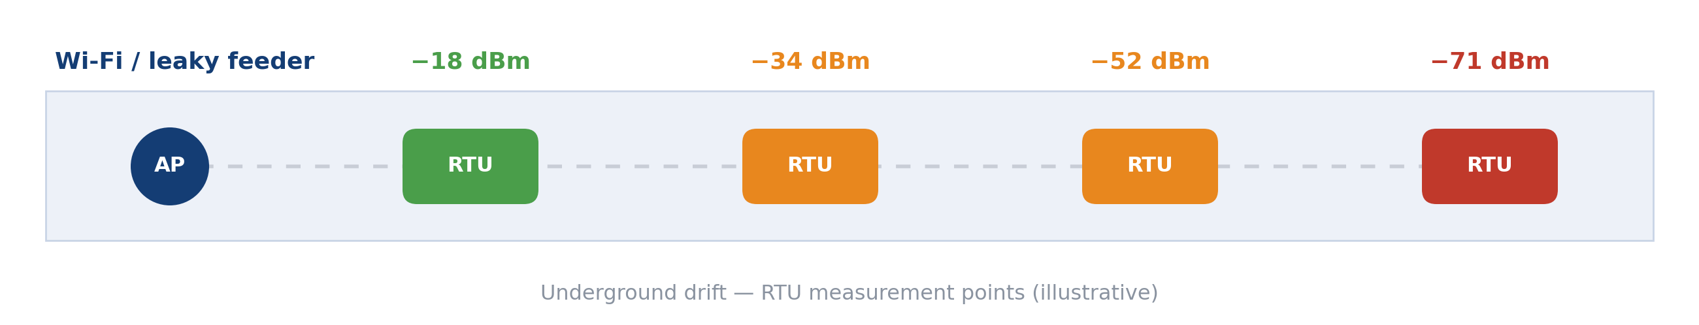
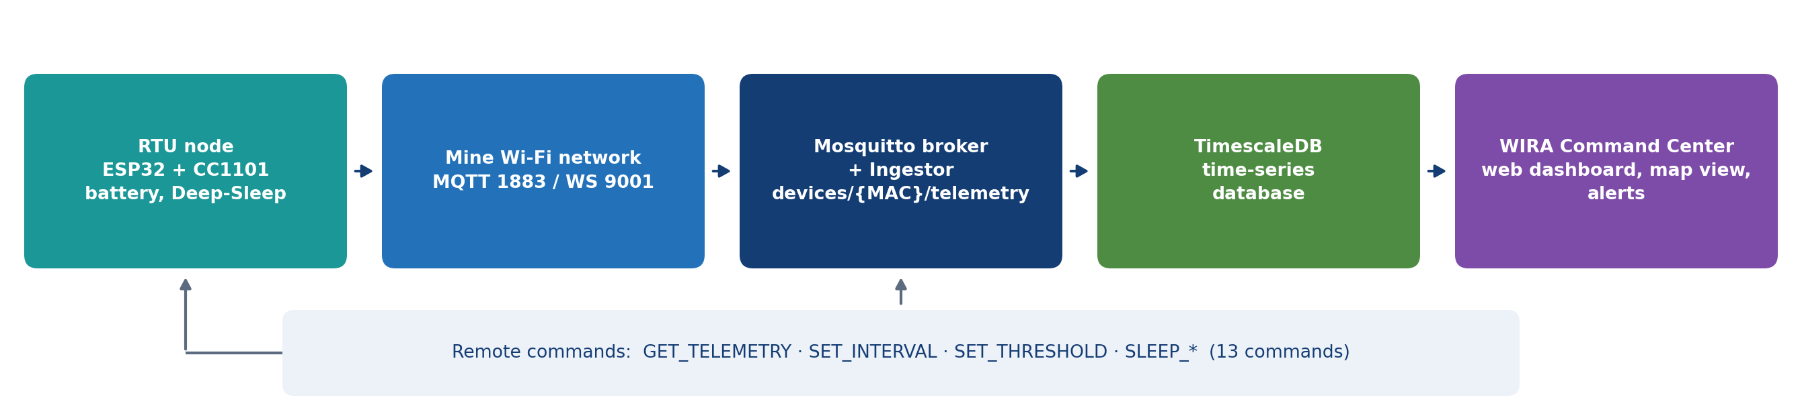
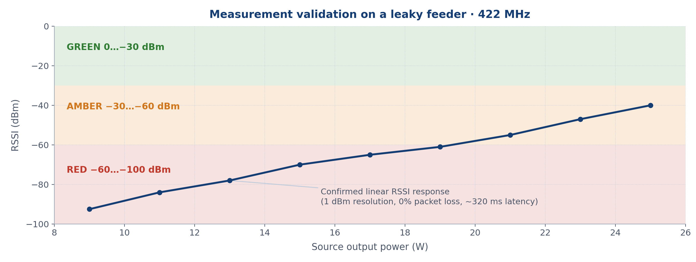
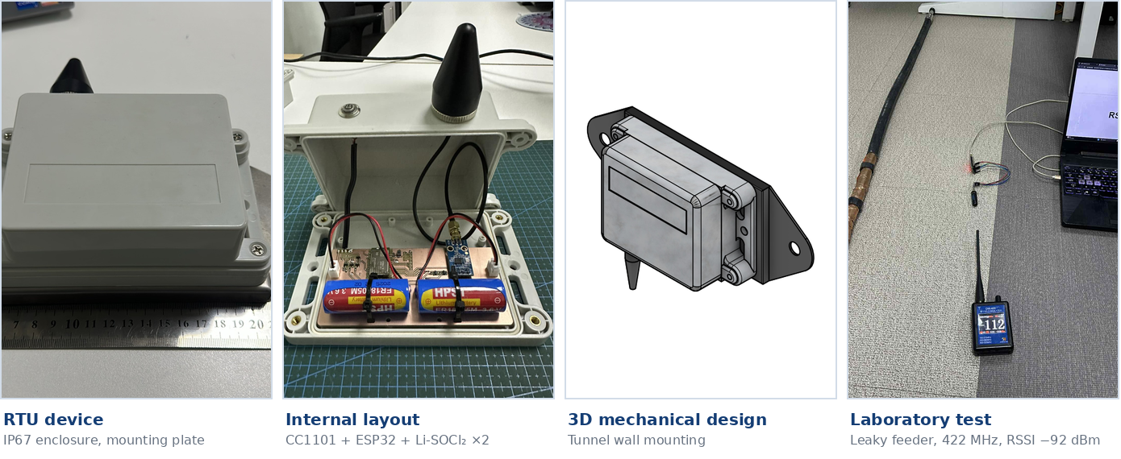


HIGHER ENGINEERING EDUCATION DEVELOPMENT (M-JEED) PROJECT
17 September 2026 | Ulaanbaatar, Mongolia
RESEARCH FIELD
A STUDY ON THE DEVELOPMENT OF SMART SYSTEMS FOR INDUSTRIAL, SERVICE, AND DOMESTIC APPLICATIONS USING ADVANCED TECHNOLOGIES
Automation and Systems Engineering
Development of a Wireless Network Radio Signal Strength Measuring RTU Device for Underground Mining
Joint research code:
J23A16-1
Keywords: RTU · RSSI monitoring · MQTT / IoT · underground mine wireless network
MUST – School of Information and Communication Technology (SICT) • Kumamoto University (Japan) • Test and research site: Oyu Tolgoi LLC, underground mine
MONGOLIAN TEAM LEADER
JAPANESE PROJECT TEAM LEADER
Professor B. Otgonbayar, Ph.D.
School of Information and Communication Technology/Department of Telecommunication Engineering
Email: otgonbayar_b@must.edu.mn
Ass. Professor Kishikawa Hiroki, Ph.D.
Tokushima University / Faculty of Science and Technology
Email: kishikawa.Hiroki@tokushima-u.ac.jp
RESEARCH TEAM MEMBER
JAPANESE COUNTERPART
B. Purevtseren (Ph.D)
Dept. of Telecommunication Engineering, MUST (Radio Frequency and Antenna Lab)
e-mail: Purevtseren_b@must.edu.mn
Prof. Takeshi Fukusako
Dept. of Computer Science & Electrical Engineering, Graduate School of Science and Technology, Kumamoto University (Microwave & Antenna Lab)
Email: fukusako@cs.kumamoto-u.ac.jp
1. PROBLEM & OBJECTIVE
2. APPROACH & COLLABORATION
Why underground radio coverage has to be monitored automatically
RTU node, MQTT telemetry and the MUST – Kumamoto – Oyu Tolgoi partnership
PROBLEM
• In underground drifts and declines, wireless signals (Wi-Fi, leaky feeder) are unstable because of dust, humidity, metal structures, blasting and moving equipment.
• Signal degradation is measured manually and irregularly, so faults cannot be detected early and the maintenance response is slow.
• Loss of communication is a direct risk to personnel and equipment tracking and to the delivery of safety-critical data.
OBJECTIVE
• Develop an RTU device that measures RSSI automatically and reports it over MQTT, running 2–2.5 years on battery.
• Introduce an alerting system that monitors network coverage 24/7 in real time and detects signal degradation early.
• Deliver a low-cost solution that Mongolian engineers can maintain themselves and roll out across the national mining sector.
APPROACH & TECHNOLOGY
• RTU node: TI CC1101 sub-GHz receiver (300–928 MHz), ESP32 MCU, Wi-Fi 2.4 GHz b/g/n + Bluetooth SPP, IP67 enclosure.
• Power: Li-SOCl₂ ER18505M 3.6 V ×2 — low thermal-runaway risk; 2–2.5 years of operation.
• Transport: JSON payload → MQTT/HTTP → local server (extensible over LTE).
• Server: MQTT broker → time-series database → web dashboard and alerts.
COLLABORATION
• MUST–SICT: hardware, firmware, software and RF measurement (SICT–RDAL laboratory).
• Kumamoto University, Microwave & Antenna Lab (Prof. T. Fukusako): antenna and propagation analysis, measurement validation — joint IEEE/IEICE papers published in 2021–2023.
• Oyu Tolgoi LLC: real underground mine test site.
3. KEY RESULTS, TECHNOLOGY / PRODUCT
Validated prototype, measured performance and the «RF Check Point» + «WIRA» package
KEY RESULTS
• A working prototype of the «RF Check Point» RTU was built, with a complete IP67 enclosure, 3D design and assembly.
• Measurement performance: RSSI −100…0 dBm across 300–928 MHz, 1 dBm resolution, RX bandwidth 58–800 kHz.
• In leaky-feeder tests, reducing source power from 25 W to 9 W moved RSSI linearly from −40 to −92.5 dBm, confirming measurement accuracy (chart below).
• Transport: 0% packet loss over MQTT, 320 ms average latency.
• The dashboard and alerting system are in operation: RSSI thresholds classified green (0…−30), amber (−30…−60) and red (−60…−100 dBm), with an audit log.
• The server architecture supports 1000+ RTUs (~50 msg/s, HA design).
TECHNOLOGY / PRODUCT
• Package: «RF Check Point» RTU device + «WIRA» monitoring software (web dashboard, map view, alerts).
• Specifications: CC1101 sub-GHz, 300–348 / 389–464 / 779–928 MHz; covers the TETRA band (380–470 MHz); IP67, −20…+60 °C.
• Safety: Li-SOCl₂ primary battery, Ex ia (IEC 60079-11) design approach — intended for gassy mine environments.
• JSON telemetry: device_id, mac, cc1101_frequency, cc1101_rssi, rssi_changed, WIFI_RSSI, battery_voltage, uptime_sec, free_heap. Configured through the ESP32 config port.
• Advantages: no cabling required, long battery life, assembled and serviced locally, lower cost than imported SCADA solutions.
• Maturity: TRL 6–7 — pilot testing under real underground mine conditions.
4. APPLICATIONS & BUSINESS POTENTIAL
Target users, deployment scenarios and the route to commercialisation
APPLICATIONS
• Continuous monitoring of wireless coverage in underground and open-pit mines.
• Temporary networks in tunnels, metro systems and infrastructure construction; IIoT network quality control in plants and warehouses.
• Users: mine communication and automation departments, IT/OT engineers, safety departments, contractors.
• Benefits: early fault detection, less manual measurement work, higher network availability, maintenance planned in advance.
• Accumulated historical RSSI data supports decisions on extending coverage and siting new access points.
BUSINESS POTENTIAL
• Assemble and manufacture the device in Mongolia and supply it to mining companies.
• Supply the monitoring software under a licence or subscription (SaaS) model with technical support.
• Joint products, technology transfer and licensing with the Japanese partner.
• Installation, commissioning and periodic measurement services together with mine service companies.
• Training and technical support packages for engineers and technicians.
• Indicative pricing: pilot 2 RTUs + software ≈ US$3,590; 100 RTUs ≈ US$69,200; 500 RTUs ≈ US$338,600; 1,000 RTUs ≈ US$674,500.
• Next markets: mining, tunnelling and infrastructure construction across Central Asia.
5. PARTNERSHIP, IMPACT & NEXT STEPS
What we are looking for, the expected impact and the 2026–2027 roadmap
WE ARE LOOKING FOR:
☑ Pilot testing ☑ Joint R&D ☑ Technology transfer
☐ Licensing ☑ Commercialization / Investment
WHAT WE EXPECT FROM PARTNERS:
• Joint measurement campaigns, antenna and firmware improvement, support towards ATEX/IECEx compliance, and co-authored publications.
IMPACT
• Economic: less network downtime and lower maintenance cost.
• Social: safer mining operations and more reliable communications.
• Environmental: fewer manual measurement trips and lower energy use.
• Human resources: stronger MSc and PhD research and engineering capacity.
NEXT STEPS
6. CONTACT & BUSINESS MATCHING
B. Purevtseren (Ph.D) | Institution: MUST, School of Information and Communication Technology (SICT), Radio Frequency and Antenna Lab.
e-mail: Purevtseren_b@must.edu.mn
Phone: +976-88772860

