Slide 1


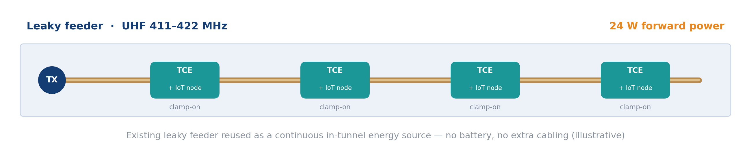
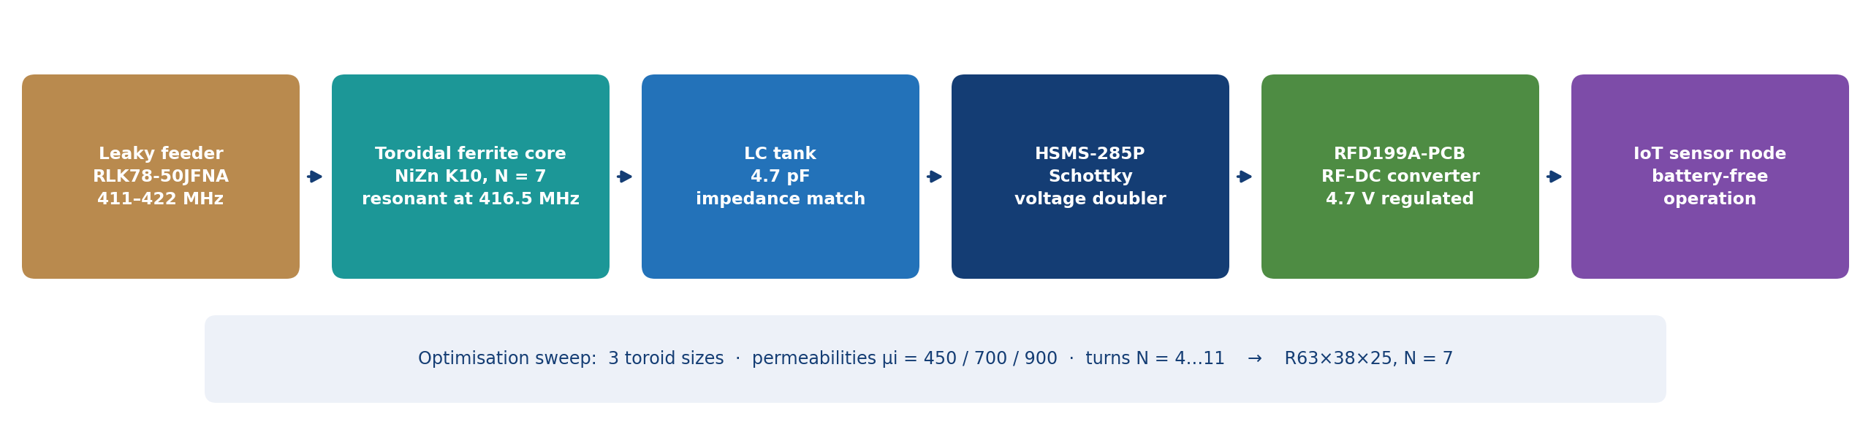
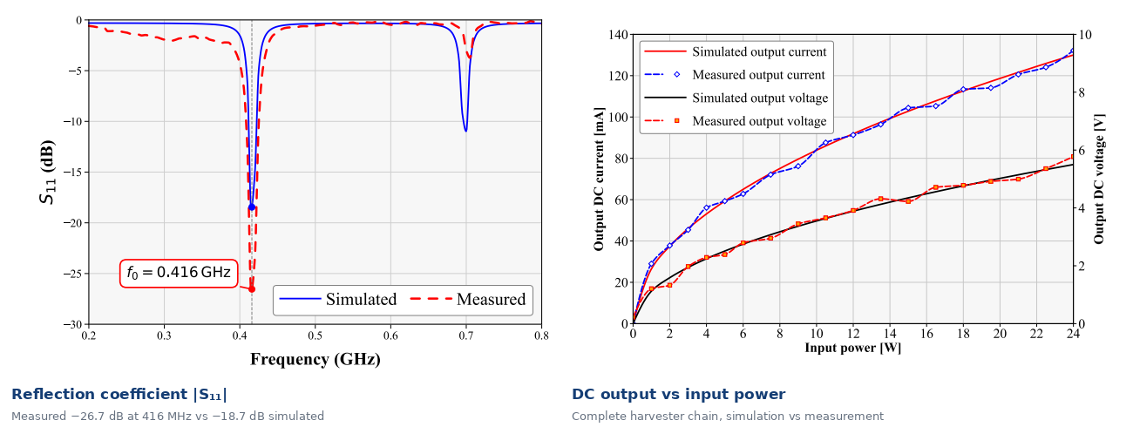
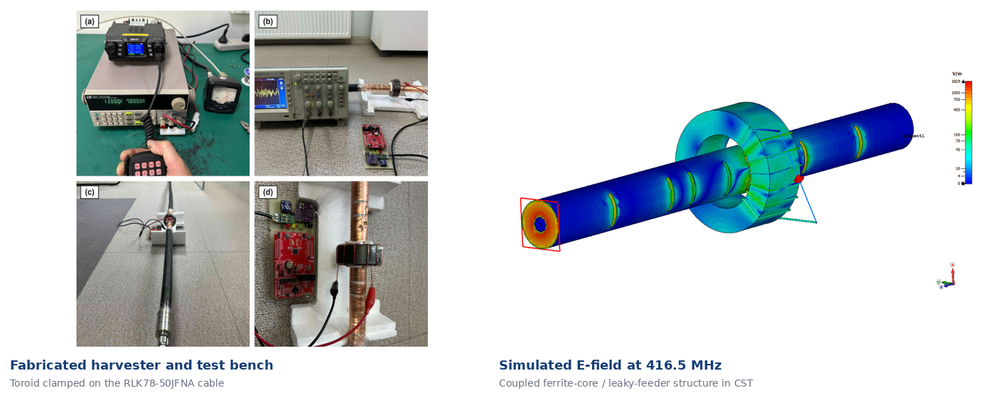
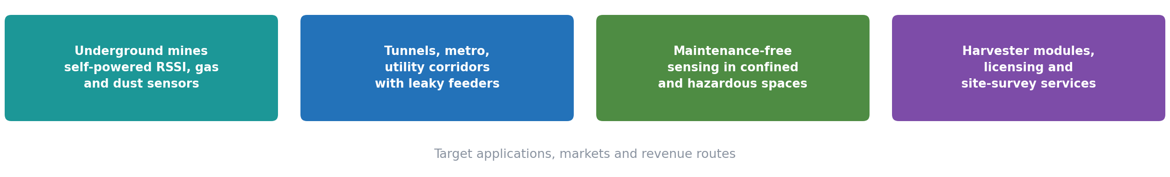
HIGHER ENGINEERING EDUCATION DEVELOPMENT (M-JEED) PROJECT
JOINT RESEARCH – BUSINESS INNOVATION PARTNERSHIP 2026
17 September 2026 | Section 4 · Energy & Renewable Energy, Room 4 | NUM Library Building, Ulaanbaatar
RESEARCH FIELD
A STUDY ON THE DEVELOPMENT OF SMART SYSTEMS FOR INDUSTRIAL, SERVICE, AND DOMESTIC APPLICATIONS USING ADVANCED TECHNOLOGIES
Automation and Systems Engineering
Low-power toroidal-core energy harvester for a leaky feeder communication system in the UHF band
Joint research code:
J23A16-1
Keywords: energy harvesting · leaky feeder · toroidal ferrite core · UHF 411–422 MHz · wireless power transfer · underground IoT
MONGOLIAN PROJECT TEAM LEADER
RESEARCH TEAM MEMBER
Professor B. Otgonbayar (Ph.D)
School of ICT (SICT) / Department of Telecommunication Engineering
Email: otgonbayar_b@must.edu.mn
B. Purevtseren (Ph.D)
Dept. of Telecommunication Engineering, SICT, MUST (Antenna Laboratory)
e-mail: Purevtseren_b@must.edu.mn
JAPANESE PROJECT TEAM LEADER
Anudari Dashbaatar, Delgermurun Batbold,
Prof. Uuganbayar Purevdorj, Prof. Chuluunbandi Naimannaran
School of Information and Communication Technology, MUST
Ass. Professor Kishikawa Hiroki (Ph.D)
Tokushima University / Faculty of Science and Technology
Email: kishikawa.Hiroki@tokushima-u.ac.jp
Prof. Juhee Choi (Ph.D)
Sangmyung University, Republic of Korea
Scan me
1. PROBLEM & OBJECTIVE
IEICE Electronics Express (SCIE), 2026 · DOI: 10.1587/elex.23.20260374
Why underground IoT nodes need a battery-free power source
2. APPROACH & COLLABORATION
PROBLEM
• Underground IoT sensor nodes need reliable power, but replacing batteries frequently is difficult and costly in confined and hazardous tunnel environments.
• Conventional ambient sources — solar, thermal, vibration — are unavailable or unreliable deep underground.
• Leaky-feeder cables already run through every drift and radiate a continuous, controlled UHF field that has so far remained unused.
OBJECTIVE
• Develop a toroidal-core energy (TCE) harvester that extracts RF energy from the near field of a UHF leaky-feeder cable and converts it into usable DC power.
• Design and optimise the harvester in CST and validate it experimentally across the 411–422 MHz operating band.
• Deliver a clamp-on, non-intrusive module able to power low-power IoT sensor nodes without cutting or re-cabling the feeder.
Ferrite-core design, CST optimisation and the MUST – Sangmyung – KOICA partnership
APPROACH & TECHNOLOGY
• Harvester: NiZn K10 ferrite toroid (R63 × 38 × 25 mm) with a 7-turn copper winding, tuned to resonance at 416.5 MHz.
• Simulation: full-wave CST transient solver; the feeder is excited through a waveguide port and terminated in a matched 50 Ω load.
• Conversion chain: LC tank → HSMS-285P Schottky voltage doubler → RFD199A-PCB RF–DC converter → regulated DC output.
• Optimisation: three toroid sizes, permeabilities μi = 450 / 700 / 900 and turns N = 4…11 were swept to maximise flux capture below Bsat ≈ 0.45 T.
COLLABORATION
• MUST–SICT: design, CST modelling, fabrication and RF measurement (Radio Frequency and Antenna Lab.).
• Sangmyung University (Korea), Prof. Juhee Choi: rectifier chain and measurement methodology.
• KOICA: funding and lab capacity building (Contract No. P2019-00124).
3. KEY RESULTS, TECHNOLOGY / PRODUCT
Simulated and measured performance of the «TCE Harvester» and its product form
KEY RESULTS
• At the 416.5 MHz resonance the toroidal winding produced 6.83 V and 71.4 mA in simulation — an AC power-conversion efficiency of 48.8%.
• Simulation and measurement agree closely: measured |S₁₁| reaches −26.7 dB at 416 MHz against −18.7 dB in simulation.
• A 24 W UHF transmitter on a 5 m RLK78-50JFNA cable delivered 6.92 V DC and 166 mA across the fixed load.
• Regulated 4.7 V DC output — continuous operation of low-power IoT nodes above +30 dBm forward power, pulsed operation below that.
• A linear-scaling post-processing method overcomes the normalised port-power behaviour of CST, enabling rapid input-power parametric studies.
• The UHF leaky feeder is established as a viable in-tunnel energy source for IoT nodes.
TECHNOLOGY / PRODUCT
• Product form: a clamp-on «TCE Harvester» module — ferrite toroid, winding, LC tank and rectifier board — fitted to an existing leaky feeder without cutting the cable.
• Core: NiZn K10 ferrite, R63 × 38 × 25 mm, N = 7 turns, 1 mm copper wire, 4.7 pF LC tank.
• Band: 411–422 MHz (resonance 416.5 MHz) — the band already used by mine leaky-feeder and TETRA-class radio systems.
• Output: 4.7 V regulated DC; 6.92 V and 166 mA measured at 24 W forward power.
• Advantages: no battery replacement, no additional cabling, non-intrusive installation, and it reuses infrastructure that already exists in every tunnel.
• Maturity: TRL 4–5 — validated on a laboratory leaky-feeder testbed and peer-reviewed in IEICE Electronics Express (SCIE), 2026.
4. APPLICATIONS & BUSINESS POTENTIAL
Where battery-free in-tunnel power matters, and how it reaches the market
APPLICATIONS
• Battery-free power for RSSI monitors, gas and dust sensors and tag readers along underground mine drifts.
• Tunnels, metro lines and infrastructure corridors where leaky feeders are already installed for radio coverage.
• Maintenance-free sensing in confined or hazardous spaces where battery changes require permits and downtime.
• Combined with the «RF Check Point» RTU project at MUST, for fully self-powered underground monitoring.
BUSINESS POTENTIAL
• Clamp-on energy harvesting modules manufactured in Mongolia as an add-on to existing leaky-feeder infrastructure.
• Bundled with underground IoT sensor products to remove battery logistics from the customer's operating cost.
• Joint products, technology transfer and licensing with the Korean partner.
• Licensing of the ferrite-core and rectifier design to communications and mining-equipment suppliers.
• Engineering services: site survey, harvested-power measurement and installation on live feeder networks.
5. PARTNERSHIP, IMPACT & NEXT STEPS
What we are looking for, the expected impact and the roadmap to 2027
WE ARE LOOKING FOR:
☑ Pilot testing ☑ Joint R&D ☑ Technology transfer
☑ Licensing ☑ Commercialization / Investment
WHAT WE EXPECT FROM PARTNERS:
• Access to live leaky-feeder networks for field trials, support on active-rectifier design and certification, and co-authored publications.
IMPACT
• Economic: removes battery replacement cost and downtime from sensor networks.
• Social: safer maintenance — fewer battery-change trips into confined and hazardous spaces.
• Environmental: fewer primary lithium batteries consumed and disposed of underground.
NEXT STEPS
6. CONTACT & BUSINESS MATCHING
B. Purevtseren (Ph.D) | MUST, SICT, Radio Frequency and Antenna Lab. e-mail: Purevtseren_b@must.edu.mn
Phone: +976-88772860

