Slide 1

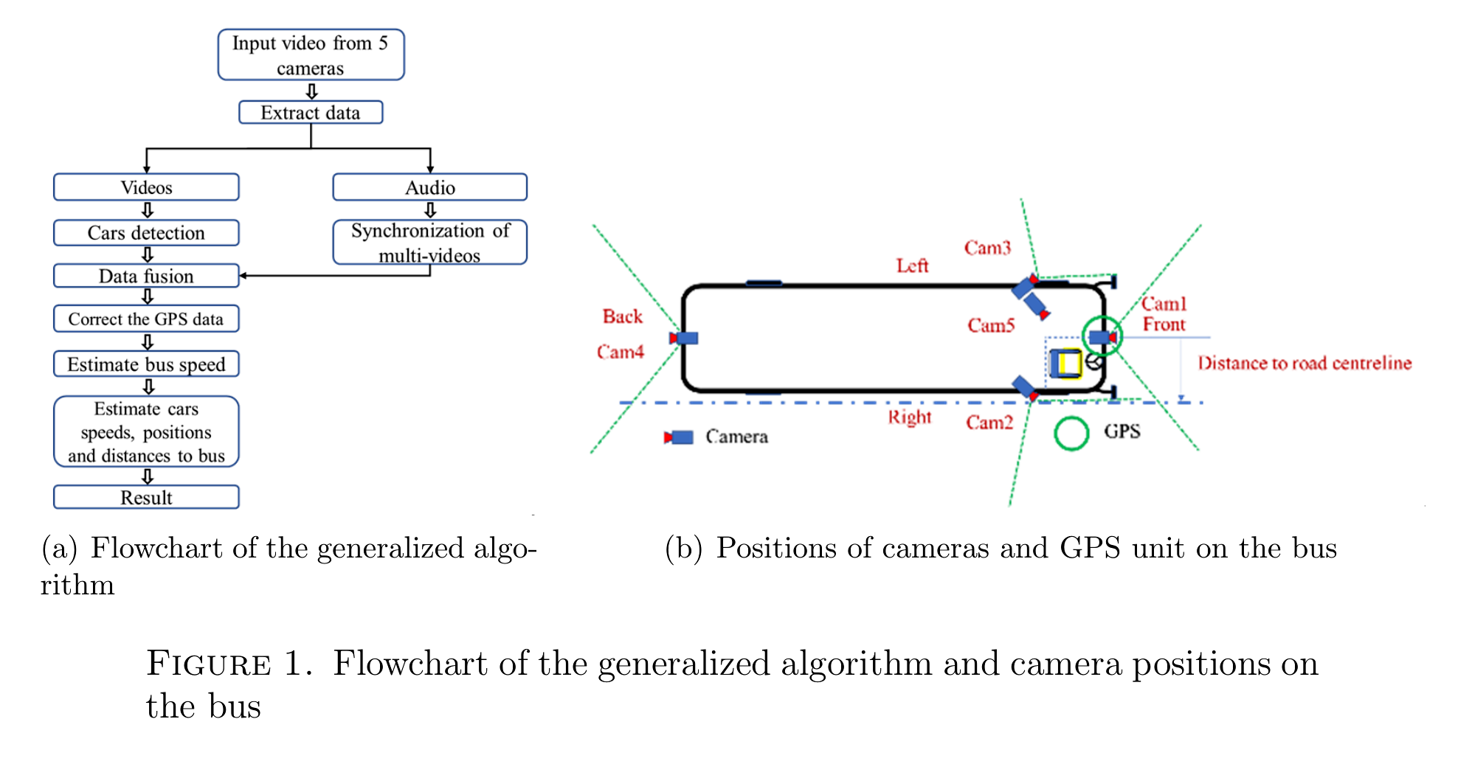
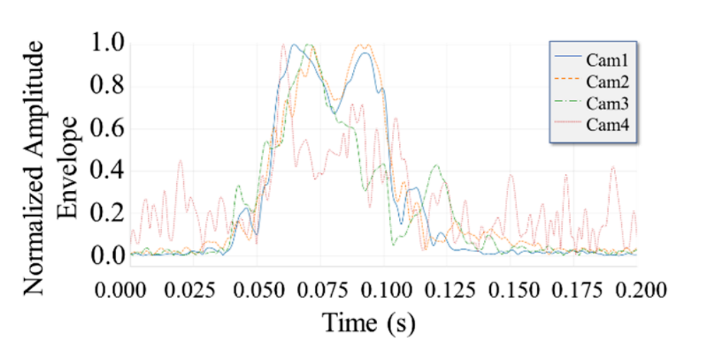
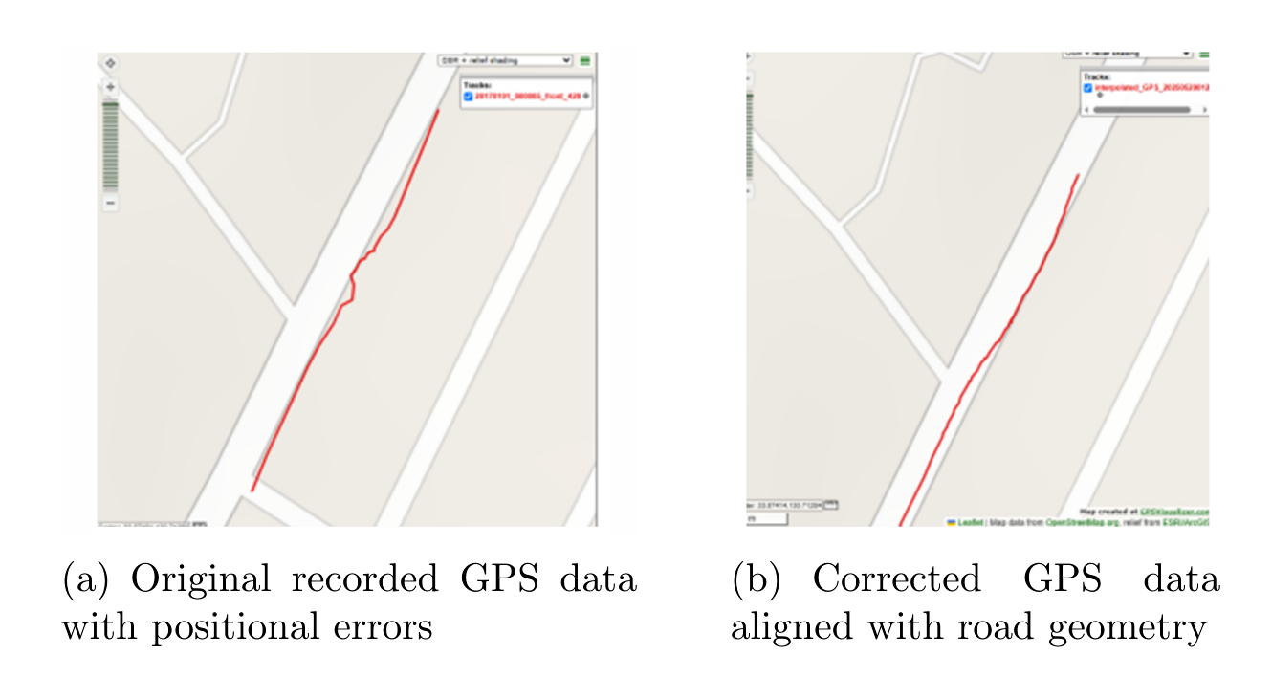
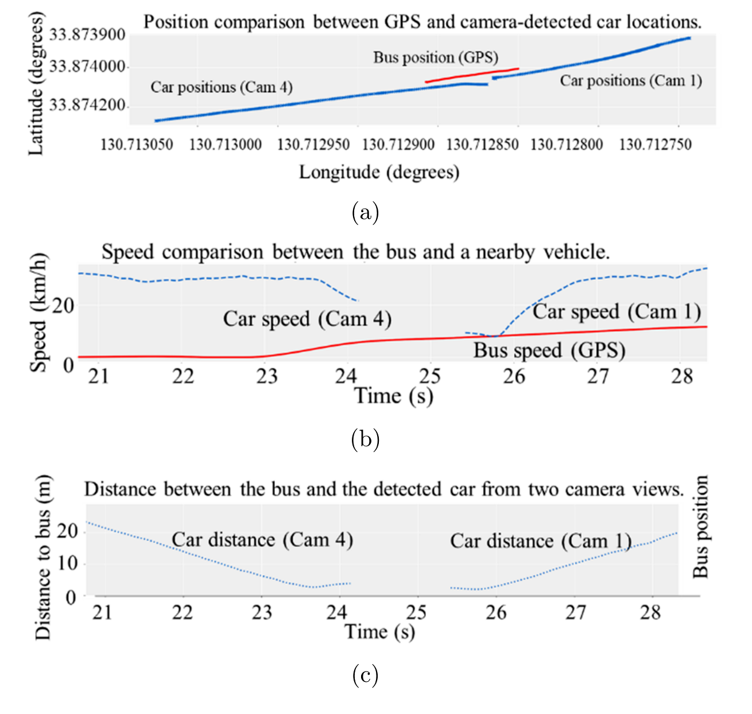
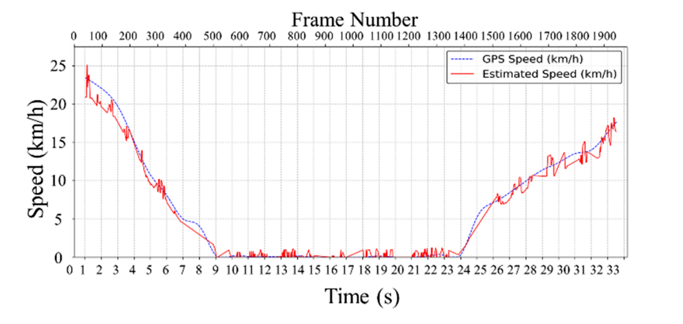
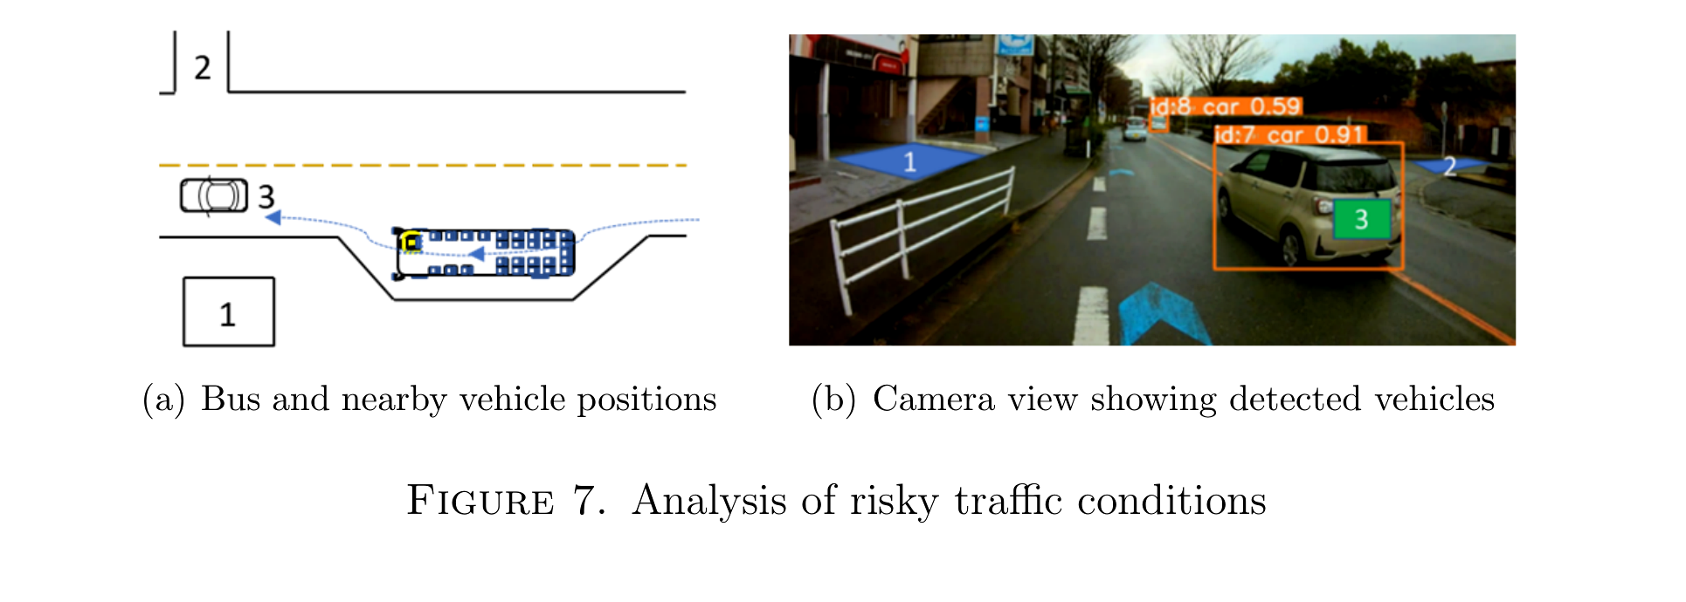
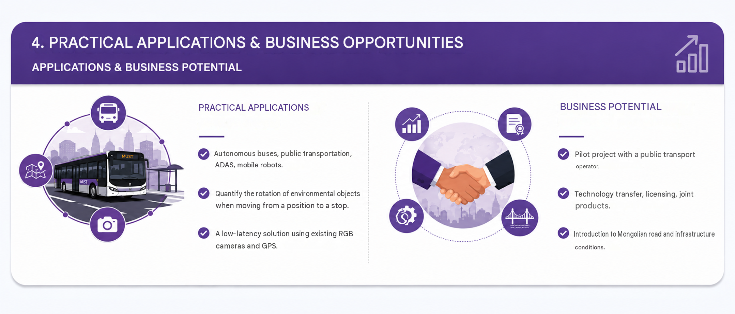
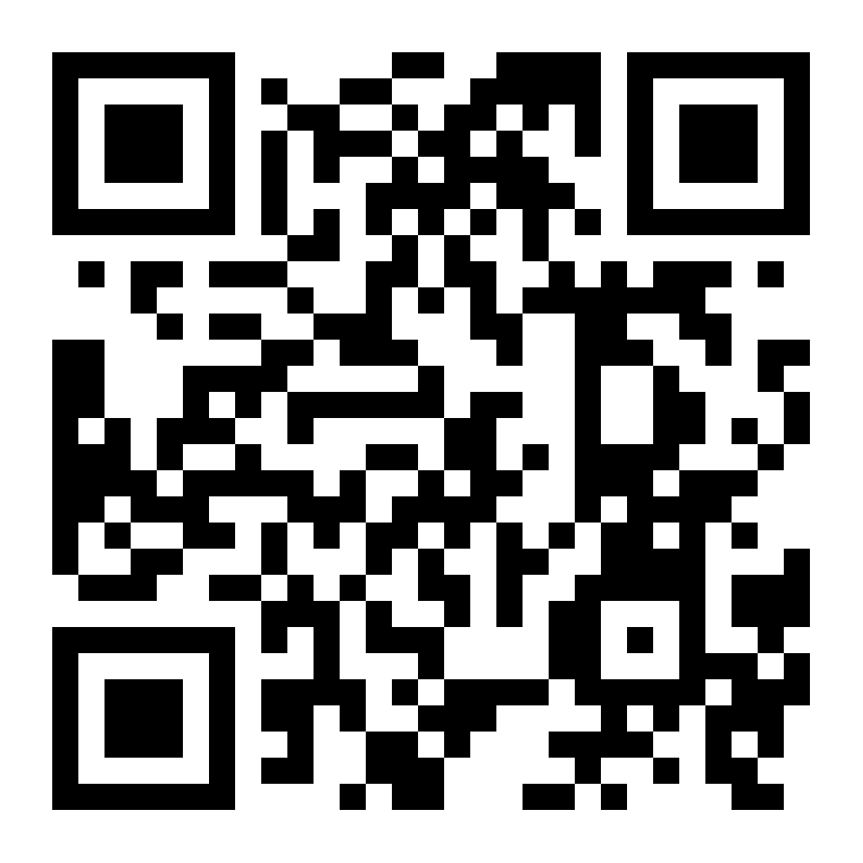
RESEARCH FIELD
The development of industrial, service and intelligent systems based on advanced technologies
Automation, system engineering
J23A16-2
Development of research and application of mechatronics in manufacturing
Keyword / Key word : autonomy bus • many camera • YOLOv9 • GPS • risk assessment
MUST–SMET • Kyushu Institute of Technology • MJEED–JICA J23A16
MONGOLIAN TEAM LEADER
JAPANESE COUNTERPART
B. Otgonbayar , Professor
Mongolian University of Science and Technology, SICT
Hiroki Kishikawa , Professor
University of Tokushima
SUB-COORDINATOR
JAPANESE SUB- COUNTERPART
B. Bayarsaikhan , Associate Professor
Mongolian University of Science and Technology, SMET
Hiroaki Wagatsuma, Professor
Kyushu Institute of Technology, Life Science and Systems Engineering
1. PROBLEM & OBJECTIVES
2. APPROACH & COLLABORATION
• Problem : out of sync camera , city GPS​ deviation , big data .
• Purpose : RGB camera , sound , GPS together object position , speed , direction , distance to evaluate .
• Ach importance : cost low autonomy public transportation safe decision support .
• 5 RGB cameras Record 2.3–3.3 kHz audio by signal synchronized .
• YOLOv9 detection land in coordinates transferred .
• GPS map matching and by interpolation trajectory edited .
• Mongolia – Japan team methodology , reality road data , evaluation together implemented .
3. KEY RESULTS, TECHNOLOGY / PRODUCT
KEY RESULTS
• 5 cameras synchronization error : −0.312 ms .
• Speed rating : 90%; MAE 2.41 km /h; RMSE 2.87 km /h; MAPE 8.7%.
• Position X/Y RMSE: 0.35/0.39 m.
• Object detection : mAP 0.91; NDS 0.76.
• Research seed 3 articles in total developed .
TECHNOLOGY / PRODUCT / TECHNOLOGY / PRODUCT
• Synchronous many camera , YOLOv9, GPS map matching, interpolation combined to process flow .
• Nearby object by position , speed , direction , distance risky conditions Evaluate .
4. PRACTICAL APPLICATIONS & BUSINESS OPPORTUNITIES
APPLICATIONS & BUSINESS POTENTIAL
PRACTICAL APPLICATIONS
• Autonomous bus , public transportation , ADAS, mobility robot .
• From the hotel moving , row replace generation nearby object the risk number to evaluate .
• Now RGB camera available and GPS​ used cost low solution .
BUSINESS POTENTIAL
• Public transportation with operator experimental project .
• Technology transmission , license , joint product .
• Mongolian road , sub structural under the circumstances localization .
5. PARTNERSHIP, IMPACT & NEXT STEPS
WE ARE LOOKING FOR:
✓ Pilot testing ✓ Joint R&D ✓ Technology transfer
✓ Commercialization / investment
IMPACT: cost low feelings • public transportation safe situation • Mongolia – Japan research human reserve
NEXT STEPS: real period processing ; verification ; driver decision in the rules Integration into AI- based .
6. CONTACT & BUSINESS MATCHING
Sub coordinator: B. Bayarsaikhan, | Lead Researcher:J.Davaanyam
Japanese Counterpart: Hiroaki Wagatsuma | Kyushu Institute of Technology

